Slide 1
Tanka Poems
Thursday 9th July 2020

Slide 2
Learning Objective:
To know the features of a Tanka poem and use them within your writing.

Slide 3
Tanka Poem
Beautiful mountains,
Rivers with cold, ice water,
Frosty snow on rocks,
Tall trees dusted like icing,
White, sparkly snowflakes falling

Slide 4
Features of a Tanka poem
What did you notice?

Slide 5
Tanka poetry
Tanka poems are:
Written about nature, seasons, love, emotions.
5, 7, 5, 7, 7 syllables

Slide 6
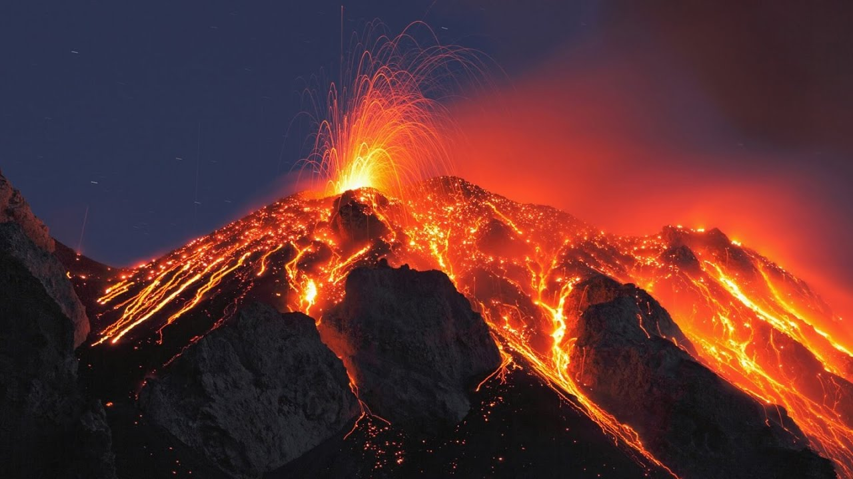
Use this image to create a Tanka poem about lava!

Slide 7
Your Turn!
Write 4 Tanka poems about 4 different things.
Your aim is to write about a natural setting and not directly name it so I can guess what you’re writing about.

Slide 8
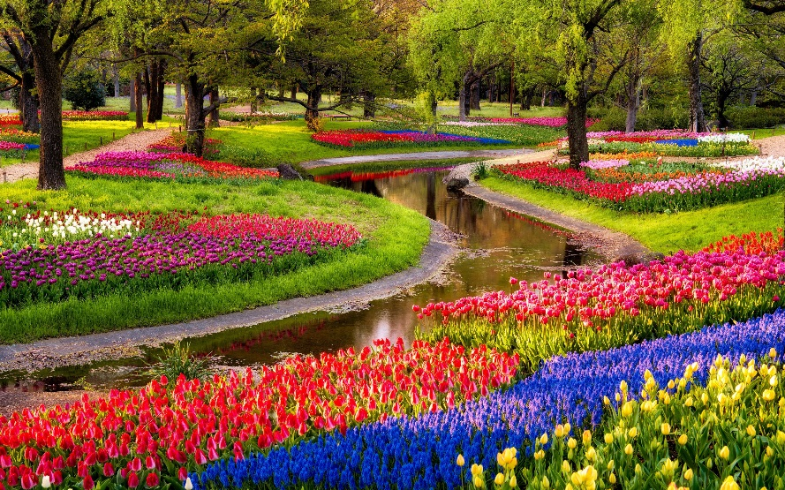
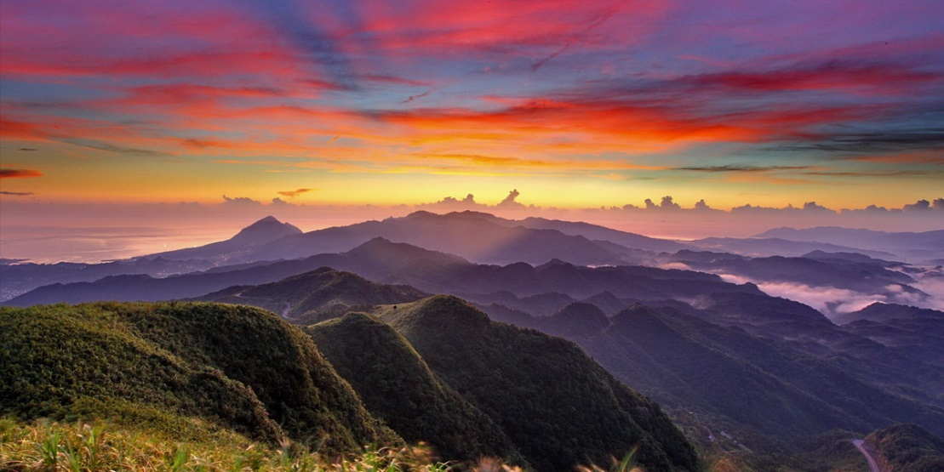
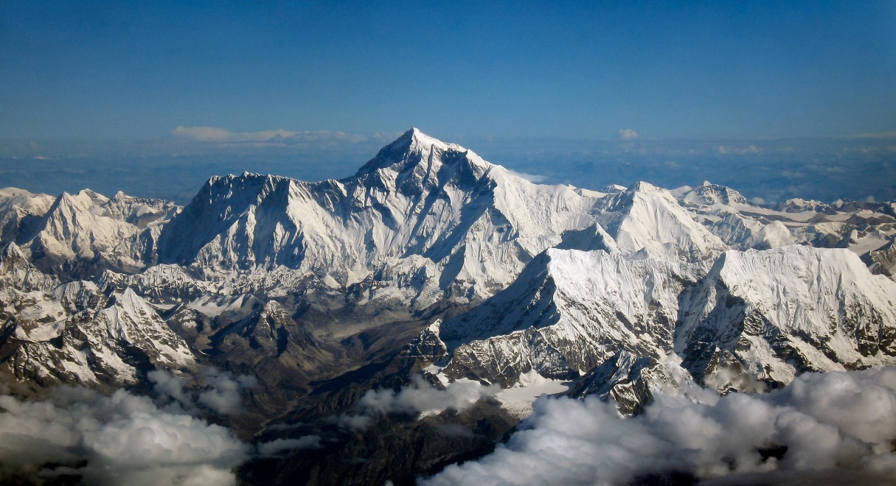
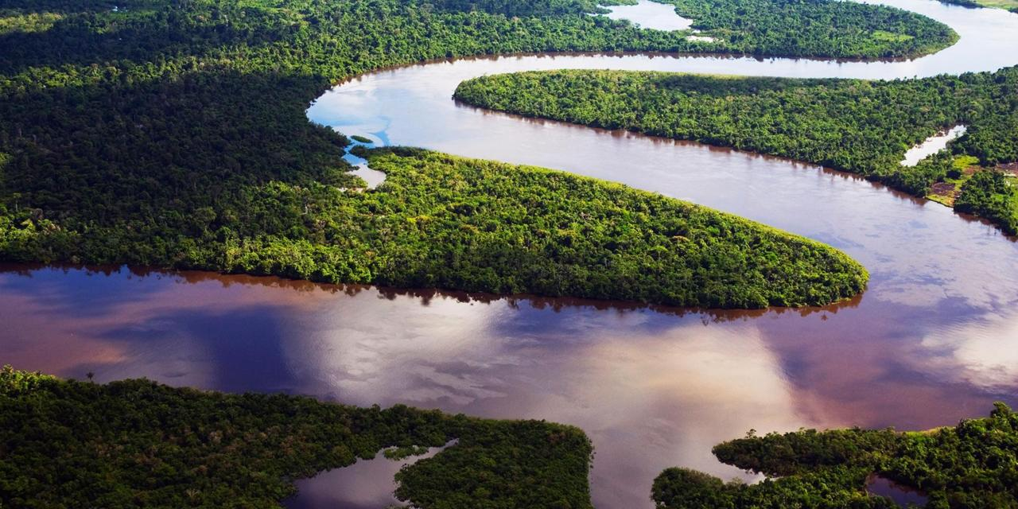
Ideas:

