Slide 2
Autobiographies
Thursday 14th April 2020

Slide 3
Learning Objective:
To read an example autobiography and answer comprehension questions.

Slide 4
Class Question
Is a diary a form of autobiography?
Have a think about this question and write your answer in your book.

Slide 5
Anne Frank
Anne Frank was a Jewish victim of the Holocaust. She wrote a diary while she was in hiding from 1942 – 1944, during the German occupation of the Netherlands in WW2.
Anne was born in Germany but lived most of her life in Amsterdam.
As persecution of the Jews increased in July 1942, the family went into hiding in concealed rooms behind bookcases in a building where Anne’s father worked.
The Franks were arrested and transported to concentration camps.
In 1944, Anne and her sister Margot were transferred from Auschwitz to Bergen-Belsen concentration camp where they both died

Slide 6
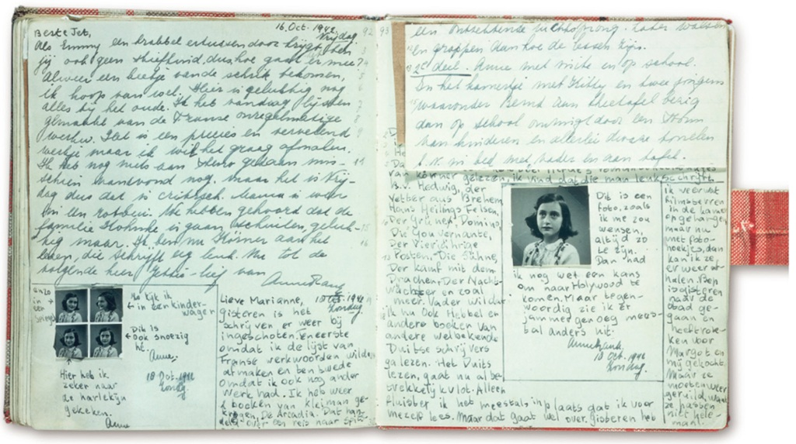
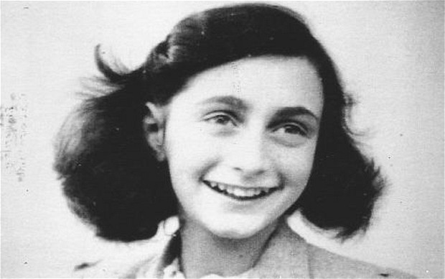
Anne Frank

Slide 7
Anne Frank’s Diary
Read the extract provided.
What are its features, is it similar to an autobiography?

Slide 8
Anne Frank
Read the comprehension and answer the questions.
Extension – Create a fact file about Anne Frank.

