Slide 2



Diving into Mastery Guidance for Educators
Each activity sheet is split into three sections, diving, deeper and deepest, which are represented by the following icons:
These carefully designed activities take your children through a learning journey, initially ensuring they are fluent with the key concept being taught; then applying this to a range of reasoning and problem-solving activities.
These sheets might not necessarily be used in a linear way. Some children might begin at the ‘Deeper’ section and in fact, others may ‘dive straight in’ to the ‘Deepest’ section if they have already mastered the skill and are applying this to show their depth of understanding.
Diving
Deeper
Deepest

Slide 3
Aim
Estimate, compare and calculate different measures, including money in pounds and pence.

Slide 4


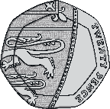

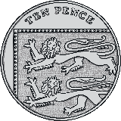
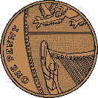
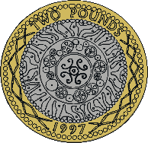
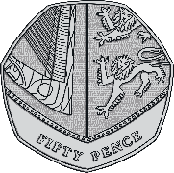
Pounds and Pence
Diving
Complete the sentences to calculate how much money is in
the savings jar.
83
In the savings jar, there is pence.
In the savings jar, there is pounds.
This is £ and pence.
There is £ in the savings jar.
2
2
83
2.83

Slide 5
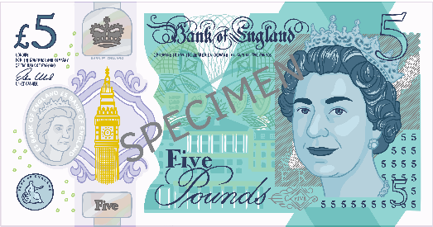

Pounds and Pence
Diving
Complete the part-whole model, writing the amount using the £ sign. Which notes or coins could you use?
£6.34
£5.10
£1.24
e.g.
£1.24 can be represented using many different coins.
Which coins did you use?

Slide 6
Pounds and Pence
Diving
Write these amounts in pounds and pence using a £ sign.
217p = __ pounds and __ pence = £__.__
27p = __ pounds and __ pence = £__.__
270p = __ pounds and __ pence = £__.__
2
17
2
17
0
27
0
27
2
70
2
70

Slide 7

Pounds and Pence
Deeper
One of these is correct. The other is incorrect.
Which is the correct answer?
Explain the error that has been made and write the correct answer.
Pence | Using £ Sign | or ✗ ? | Error/Correct Answer
907p | £9.07
840p | £8.4
✓
There should be 2 digits after the decimal point. £8.40 is the correct answer.
✗

Slide 8
Pounds and Pence
Deeper
Luckman has 5 coins that make £1.26 in total. Four of the coins are given. Explain which of the following sets of coins Luckman could have and write what the missing coin is.
50p, 50p, 20p, 5p, ?p
✓ Luckman could have this set of coins as they total £1.25 and the missing coin is a 1p.
1p
£1, 10p, 10p, 2p, ?p
Luckman cannot have this set of coins as they total £1.22 so the missing amount is 4p, which cannot be made with 1 coin.
£1, 10p, 5p, 1p, ?p
✓ Luckman could have this set of coins as they total £1.16 and the missing coin is a 10p.
10p

Slide 9


Pounds and Pence
Deepest
Here are some coins:
Lucas has 4 of these coins. Decide whether these statements about the coins are always, sometimes or never true. Explain why you think this and give examples to prove it.
Lucas has more than £4.
Never.
If Lucas had the 4 greatest value coins, the total would be £2 + £1 + 50p + 20p = £3.70 so he can never have more than £4.

Slide 10
Pounds and Pence
Deepest
Here are some coins:
Lucas has 4 of these coins. Decide whether these statements about the coins are always, sometimes or never true. Explain why you think this and give examples to prove it.
b) Lucas has less than 10p.
Sometimes
If Lucas had the 4 smallest value coins, the total would be 5p + 2p + 1p + 1p = 9p so this is less than 10p so the statement is not true.
However, if Lucas had 20p + 10p + 10p + 5p this makes a total of 45p which is greater than 10p so the statement is true.
Overall, the statement is sometimes true.

Slide 11


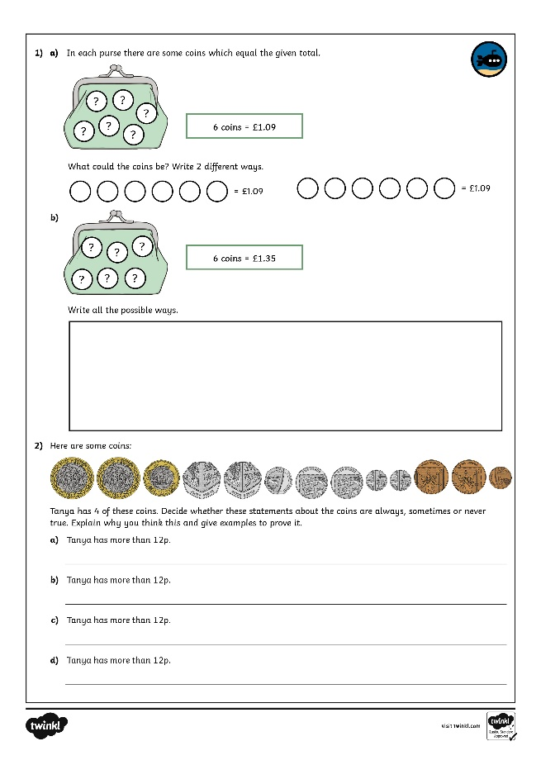
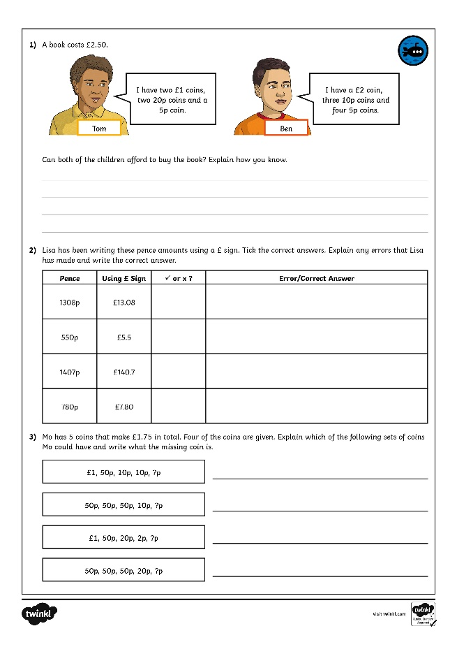
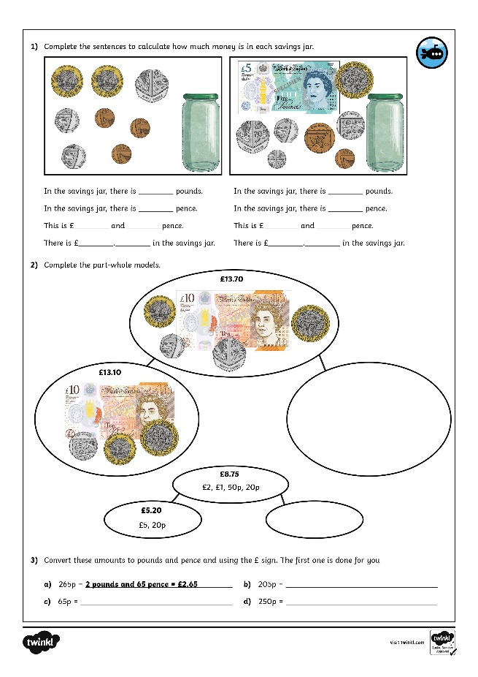
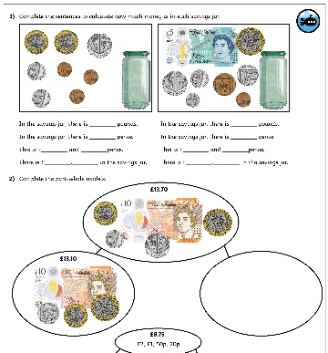

Pounds and Pence
Dive in by completing your own activity!

Slide 12
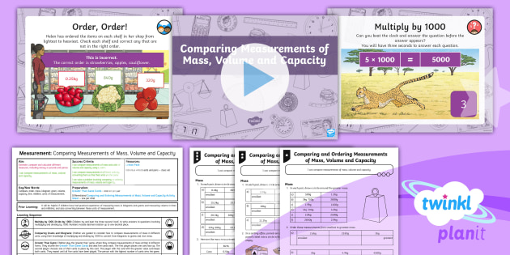
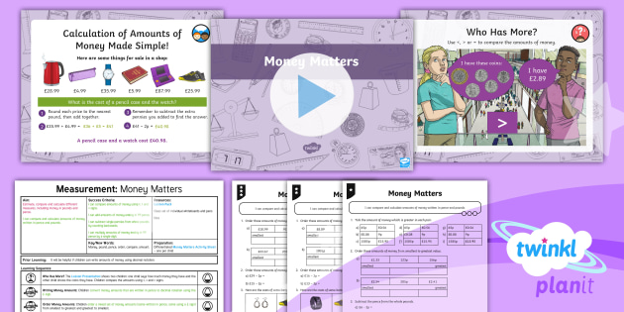

Need Planning to Complement this Resource?
National Curriculum Aim
Estimate, compare and calculate different measures, including money in pounds and pence.
For more planning resources to support this aim, click here.
Twinkl PlanIt is our award-winning scheme of work
with over 4000 resources.

