Slide 2
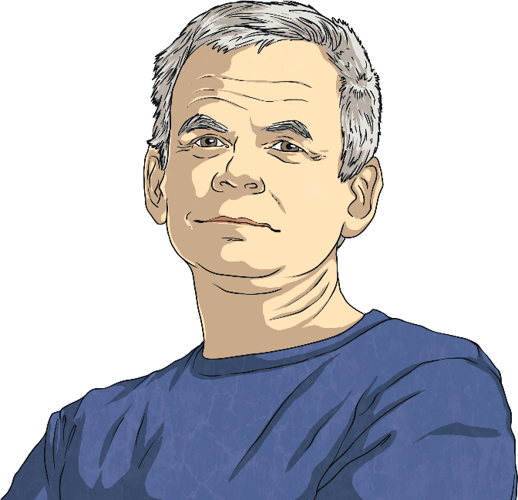
Andy Goldsworthy
Andy Goldsworthy is a British artist. He is known for his work in sculpture and photography. Andy is an environmentalist and this is reflected in the nature-based aspect of much of his work.
Andy was born on 25th July 1956 in Cheshire. When Andy was 13, he got a job as a labourer on a farm.
He studied fine art at Bradford College of Art. Fine art is often described as ‘art for art’s sake’; drawings, sculptures and paintings that have no use other than being beautiful.
Did You Know?
Andy said his work on the farm helped prepare him for creating sculptures later in life. He said, “A lot of my work is like picking potatoes; you have to get into the rhythm of it.”

Slide 3
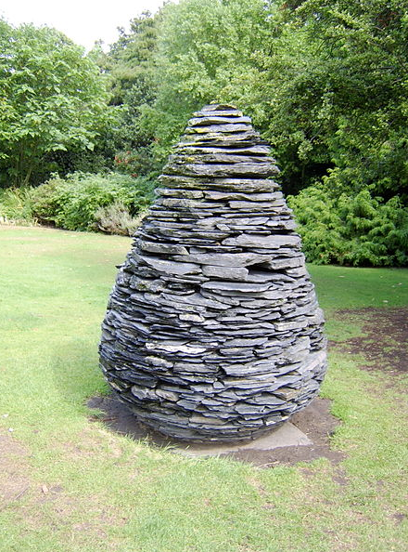
Nature
Andy describes his art as working “with nature as a whole”. His sculptures are often made up of stones, twigs, flowers, mud, snow and icicles. Many of Andy’s sculptures are created on the site where the objects are found. This is called land art or environmental art.
This is one of Andy’s slate cone sculptures. Andy cut different shapes of slate and put them together in the shape of a pine cone. There are several versions of this sculpture across the world. This one is in the Botanical Gardens in Edinburgh.
“Slate Cone” by Wolfgobbler is licensed under FAL

Slide 4



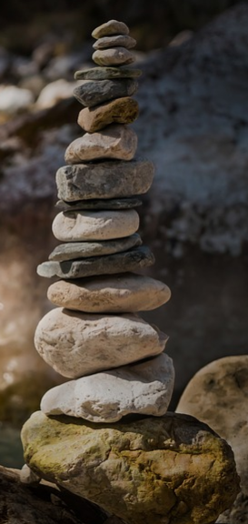
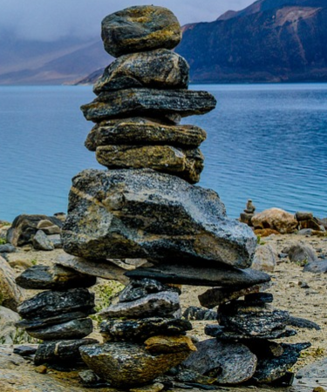
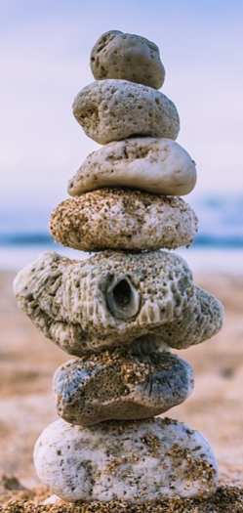
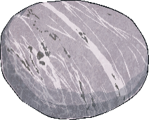
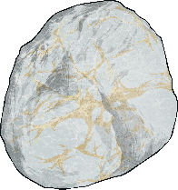
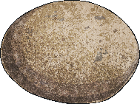

Rock Balancing
Andy has made rock balancing popular. Rock balancing is a form of art where rocks and pebbles are balanced on each other without using glue, wires or anything else to keep them together. It can be done on a small or large scale. Here are some examples of rock-balancing sculptures that people have made.

Slide 5
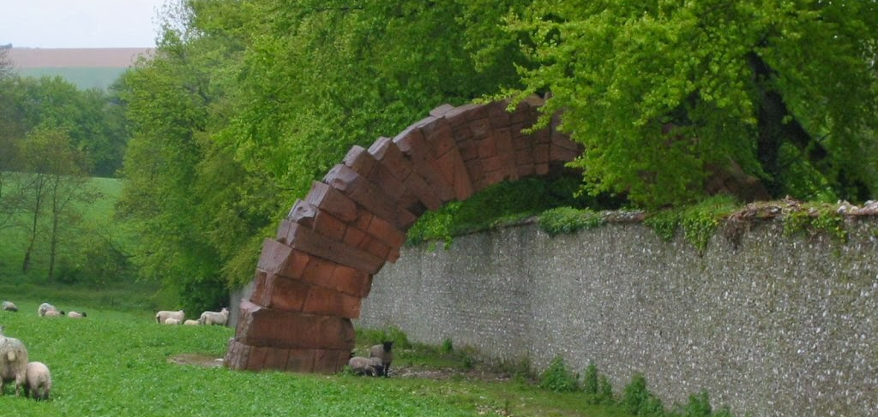
Striding Arches
This is part of a project called Striding Arches in Cairnhead, Scotland. It is made of red sandstone and goes across a large, circular, naturally-formed wall. Andy has also made arch sculptures in other parts of the world.

Slide 6
Drawn Stone
San Francisco, USA has frequent earthquakes.
In 2005, Andy produced a work for the entrance of the de Young Museum in San Francisco called Drawn Stone
The piece was made of a giant crack in the pavement that turns off into smaller cracks to mimic what would happen in an earthquake. There are also benches made of broken pieces of limestone to make people think about the damage caused by earthquakes.

Slide 7

Photography
Andy also works with photography. He often takes photos of his sculptures over time to show how nature changes them.
Explaining why he takes photos, Andy said, “Each work grows, stays, decays… parts of a cycle which the photograph shows at its heights, marking the moment when the work is most alive.”
How do you think Andy’s sculptures change over time? Why do you think he chooses to create sculptures outside, where he knows they might ‘decay’?
Talk About It

Slide 8
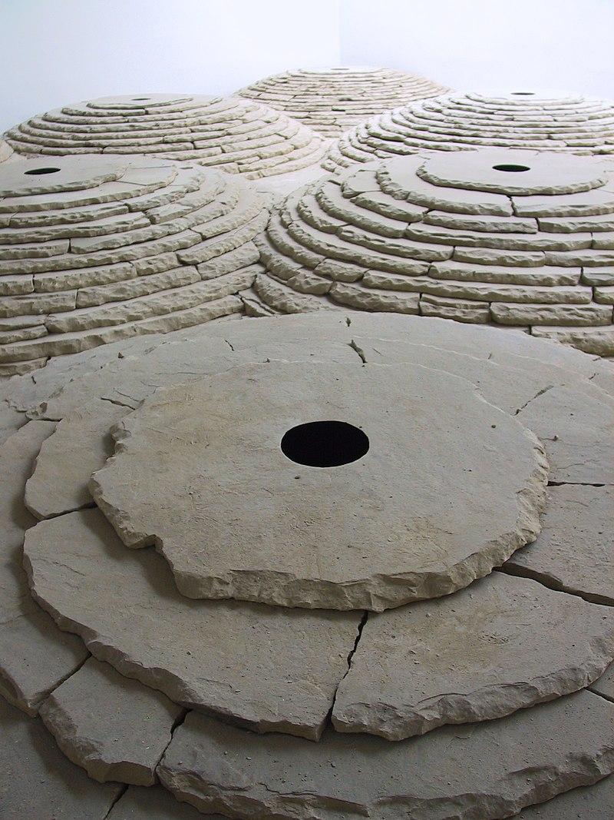
Life As An Artist
Andy now lives in Dumfries and Galloway, Scotland. In 2000, he was given a special award called the OBE (Order of the British Empire) by The Queen. This means his full title is Andy Goldsworthy, OBE.
A director named Thomas Riedelsheimer has made two films about Andy’s life, called ‘Rivers and Tides’ and ‘Leaning into the Wind’.
Andy continues to travel the world building on-site sculptures.

