Slide 2

Multiplication Word Problems
×2, ×5 and ×10
Tom buys three cinema tickets costing five pounds each.
How much does he spend?
Let’s look at how you would work this out.
You could add…
Each ticket is £5 so you would add 5 for each cinema ticket.
5 + 5 + 5 = 15
If you are repeating the same number in an addition number sentence, this is a multiplication.
5 × 3 = 15
You can read
this as ‘5 three times’.

Slide 3

Multiplication Word Problems
×2, ×5 and ×10
Sam has four plant pots.
She wants to plant two beans in each pot.
How many beans must she buy?
Let’s look at how you would work this out.
You could add…
Sam wants to plant 2 beans in each pot.
2 + 2 + 2 + 2 = 8
If you are repeating the same number in an addition number sentence, this is a multiplication.
2 × 4 = 8
You can read
this as ‘2 four times’.

Slide 4

Multiplication Word Problems
×2, ×5 and ×10
Five judges each give Mark a score of ten.
How much did he score altogether?
Can you show this as an addition number sentence?
Check your answer
10 + 10 + 10 + 10 + 10 = 50
Can you show this as a multiplication number sentence?
Check your answer
10 × 5 = 50
You can read this as ’10 five times’.

Slide 5

Multiplication Word Problems
×2, ×5 and ×10
There are six sunflowers in the garden. Each sunflower
has five petals. How many petals do the sunflowers have altogether?
Can you show this as an addition number sentence?
Check your answer
5 + 5 + 5 + 5 + 5 + 5 = 30
Can you show this as a multiplication number sentence?
Check your answer
5 × 6 = 30

Slide 6

Multiplication Word Problems
×2, ×5 and ×10
A large taxi can carry ten people to the party. If three taxis
arrive at the same time. How many people arrive at the party?
Can you show this as an addition number sentence?
Check your answer
10 + 10 + 10 = 30
Can you show this as a multiplication number sentence?
Check your answer
10 × 3 = 30

Slide 7


Division Word Problems
÷2, ÷5 and ÷10
Bella has ten wormeries and thirty worms to share
equally between them. How many worms go in each wormery?
Let’s look at how you would work this out.
You could share the 30 worms into 10 equal groups…
You add 1 worm into each group and repeat until all have been shared.
If you are sharing an amount equally this is division.
30 ÷ 10 = 3
You can read this as ‘30 shared equally between 10’.

Slide 8
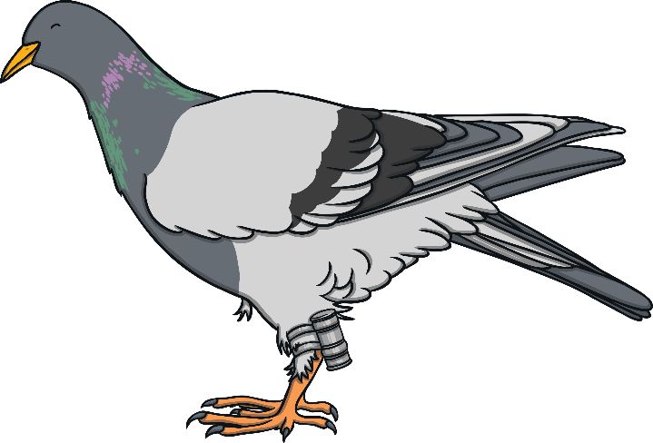

Division Word Problems
÷2, ÷5 and ÷10
Bob has thirty five pigeons in his collection. He can house
five pigeons in each cage. How many cages does he need to house all the pigeons?
Let’s look at how you would work this out.
You could share the 35 pigeons into equal groups…
You add 5 pigeons in the first group then begin adding 5 pigeons to the next group. Repeat until all pigeons have been shared equally.
If you are grouping an amount into equal
groups this is division.
35 ÷ 5 = 7
You can read this as ‘35 divided into groups of 5’.

Slide 9

Division Word Problems
÷2, ÷5 and ÷10
A sweet-making machine puts ten lollies in each bag.
If the machine makes ninety lollies in total. How many bags can it fill ?
Can you show this as a division number sentence?
Check your answer
90 ÷ 10 = 9

Slide 10

Division Word Problems
÷2, ÷5 and ÷10
Joe has twelve small chocolate bars and wants to share them between himself and his little brother.
How many chocolate bars do they each get?
Can you show this as a division number sentence?
Check your answer
12 ÷ 2 = 6

Slide 11
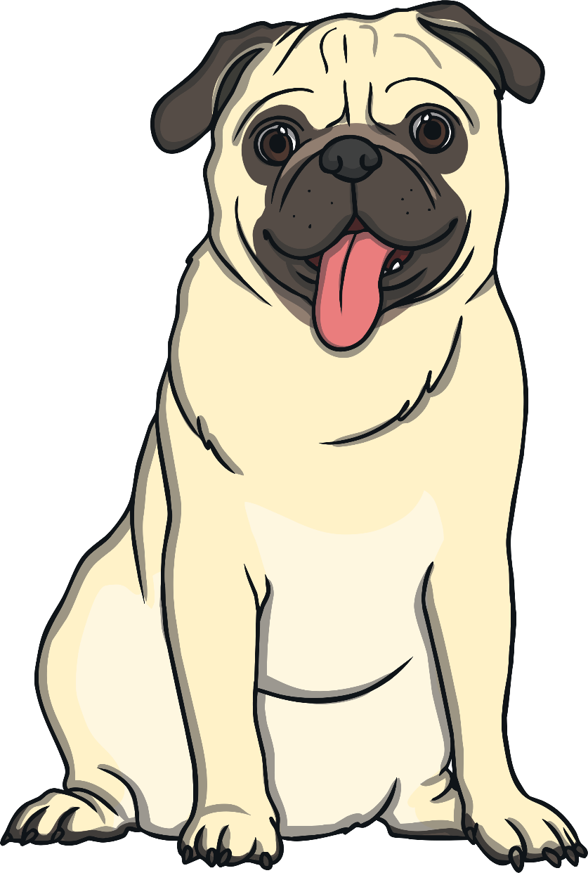
Division Word Problems
÷2, ÷5 and ÷10
Mel counts 40 small dog biscuits left over in her bag. She wants to share them between her 5 dogs.
How many dog biscuits does each dog get?
Can you show this as a division number sentence?
Check your answer
40 ÷ 5 = 8

