Slide 1
Friday 26th June 2020
L.O. To write a character description
My Monster

Slide 2
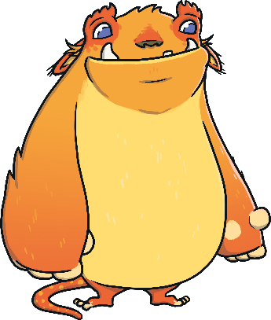
Describing a Monster
Let’s try to put some of our ideas from yesterday into sentences.
Here’s an example of one sentence that could describe a monster:
  The huge monster had a long green tail with a pointy spike at the end.
Think of a sentence to describe something about the monster you have made.

Slide 3
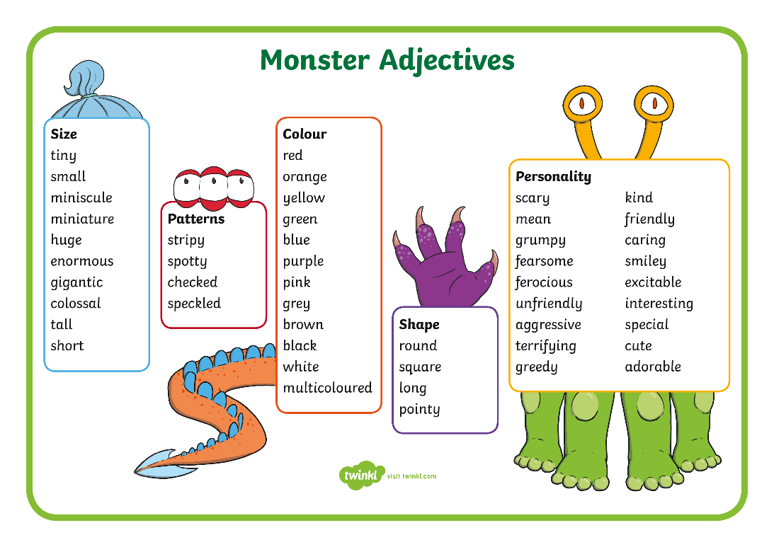
Write Your Monster Description
Now, think about how you would describe your own monster.
Write down some words and phrases that you could use.
Then, write your own sentences to describe the monster you have created.

Slide 4
Remember to use conjunctions.
Use a range of different adjectives and describe all of its features.
Year 1- 4 sentences
Year 2- Half a side of writing.
Use an exclamation sentence.
Include commas in lists.
Please send me photograph of your writing via Seesaw. I can’t wait to see your monsters.

