Slide 1
Thursday 25th June 2020
L.O. To design a monster and add adjectives.
My Monster

Slide 2
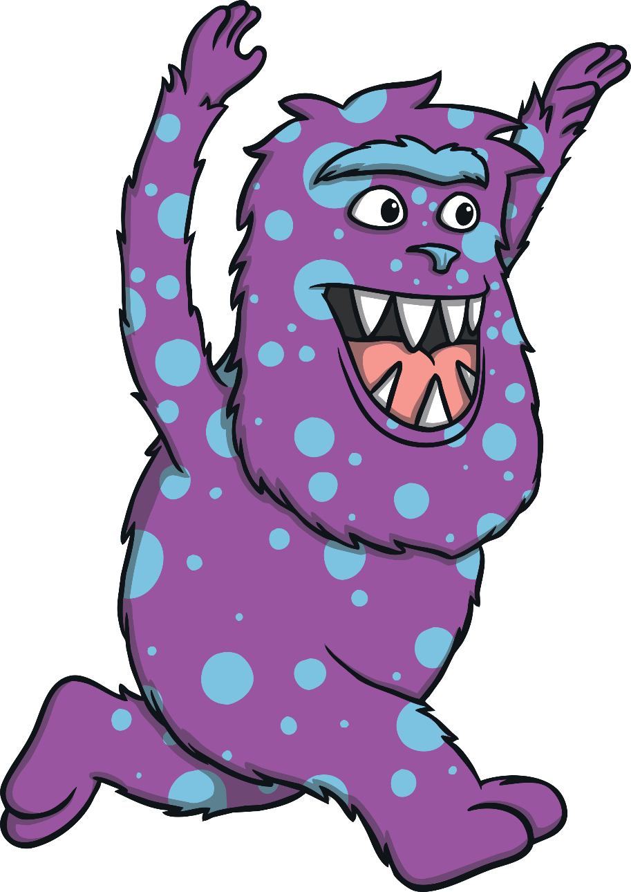
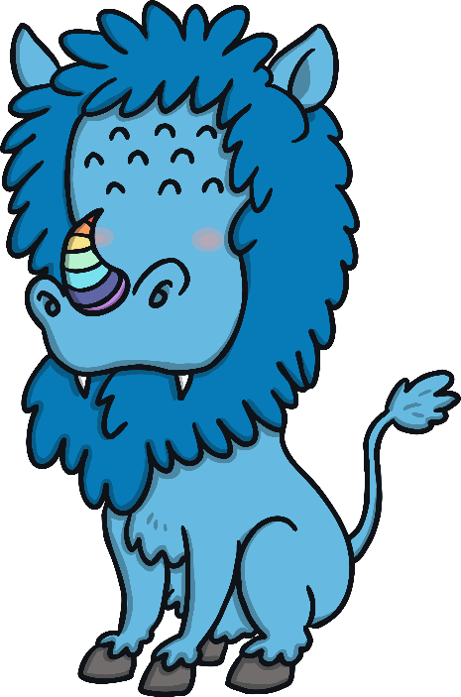
Made-Up Monsters
Monsters are imaginary creatures.
This means that we can create our own monsters!
We can use our own ideas to make up the monsters.
We can choose what
our monsters look like
and add any features
we want.

Slide 3
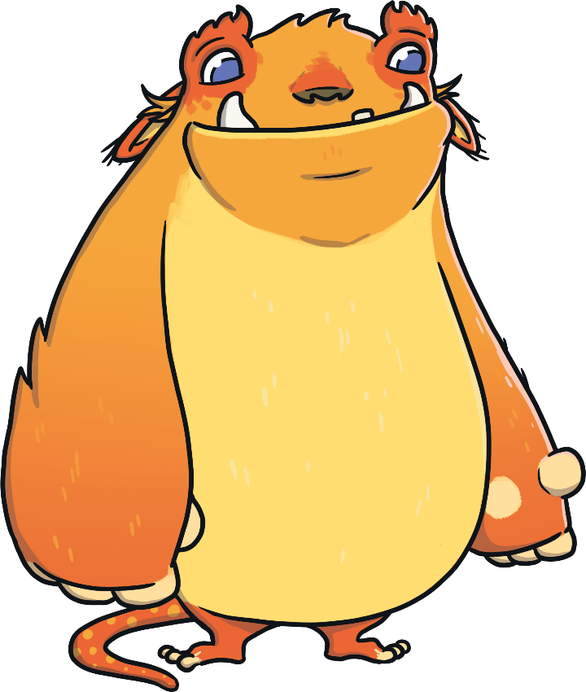
What Is a Feature?
This monster has two eyes.
What other features can you see on this monster?
Talk to your partner.
two eyes
wide mouth
white tusks
floppy ears
black nose
orange fur
yellow tummy
big paws
tiny feet
spotty tail

Slide 4
Creating a Monster
Let’s make a monster together.
First, we need to choose a shape for our monster’s body.
Draw your own monster in your home learning book! You will need it tomorrow!

Slide 5
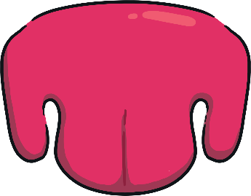
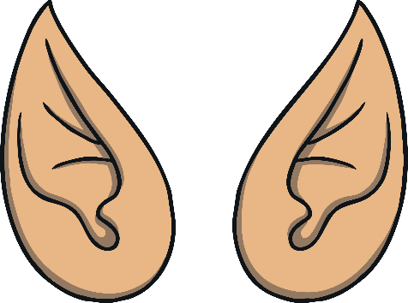
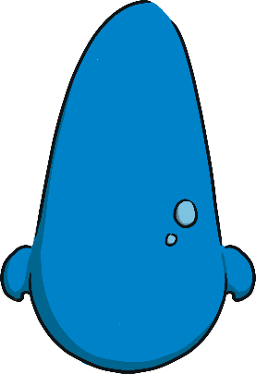
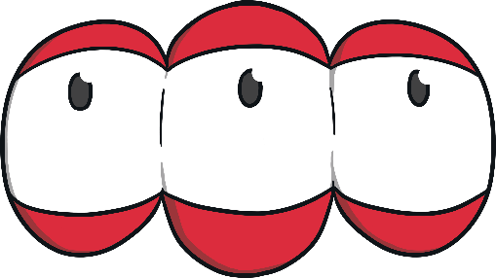
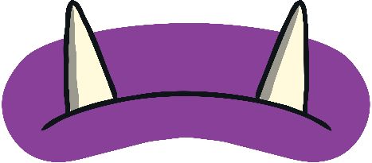
Creating a Monster
Let’s add a head and a face.
How many eyes does it have?
How big is its nose?
What do its ears look like?
What shape is its mouth?
Does it have tusks?

Slide 6
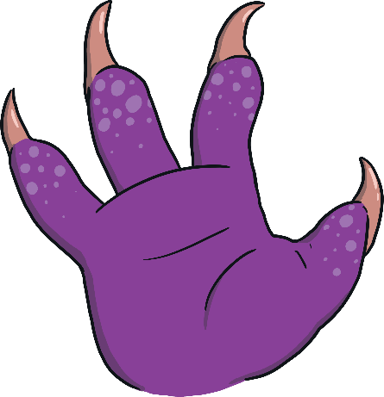
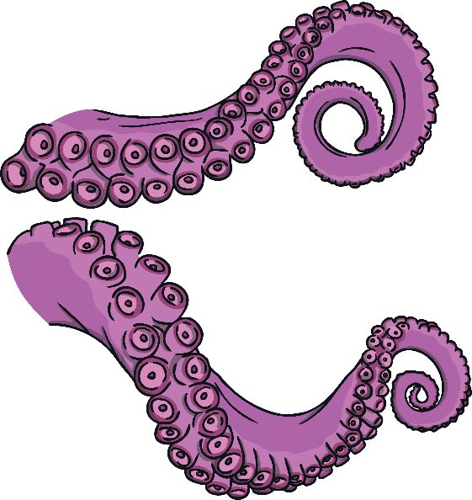
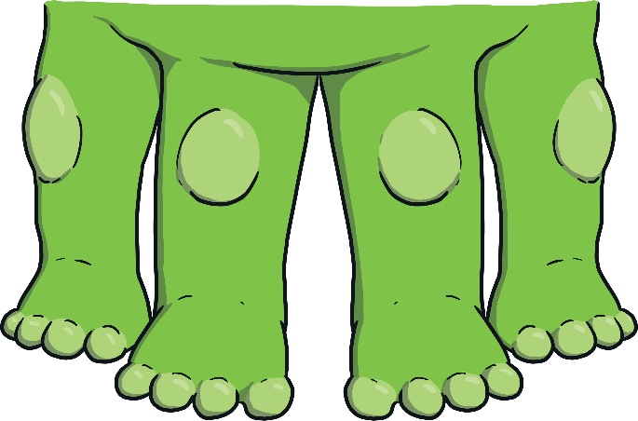
Creating a Monster
Does the monster have arms or legs?
Does it have paws or claws?
Does it have tentacles?

Slide 7
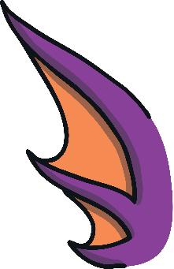
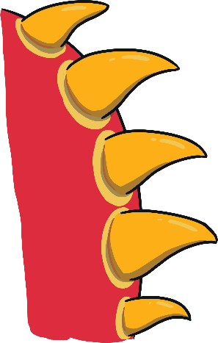
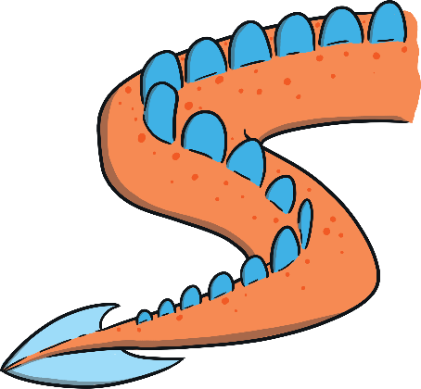
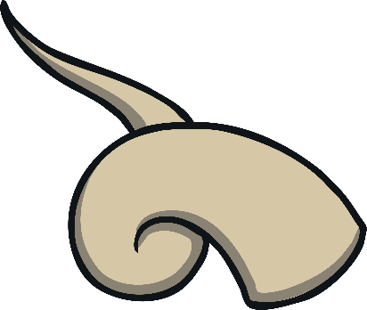
Creating a Monster
Let’s think about the other features a monster might have.
Shall we add wings?
Does it have horns?
Has it got a tail?
What about spikes?

Slide 8
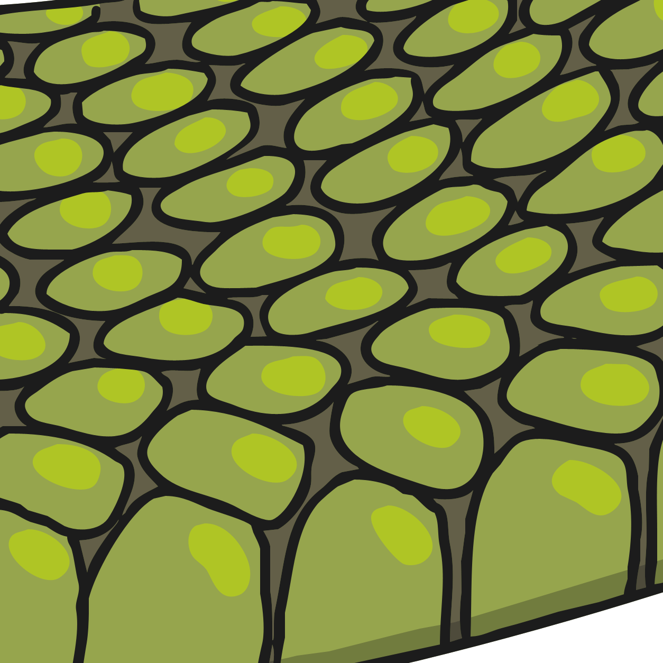
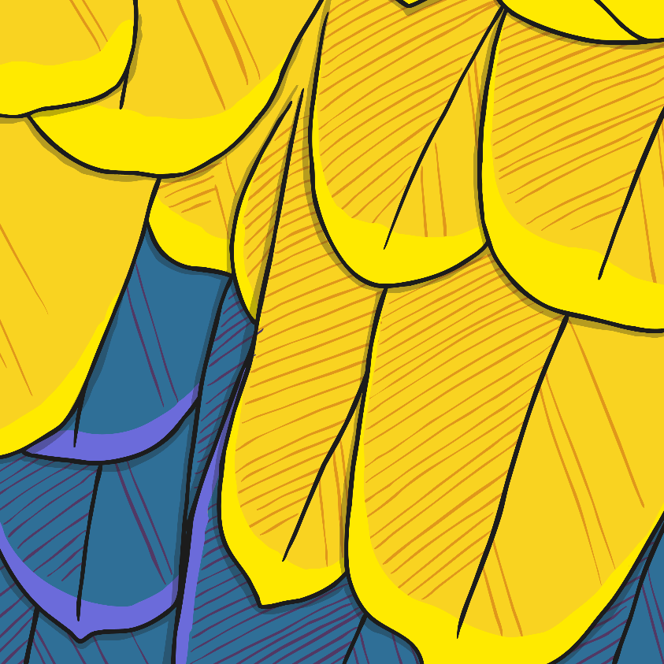
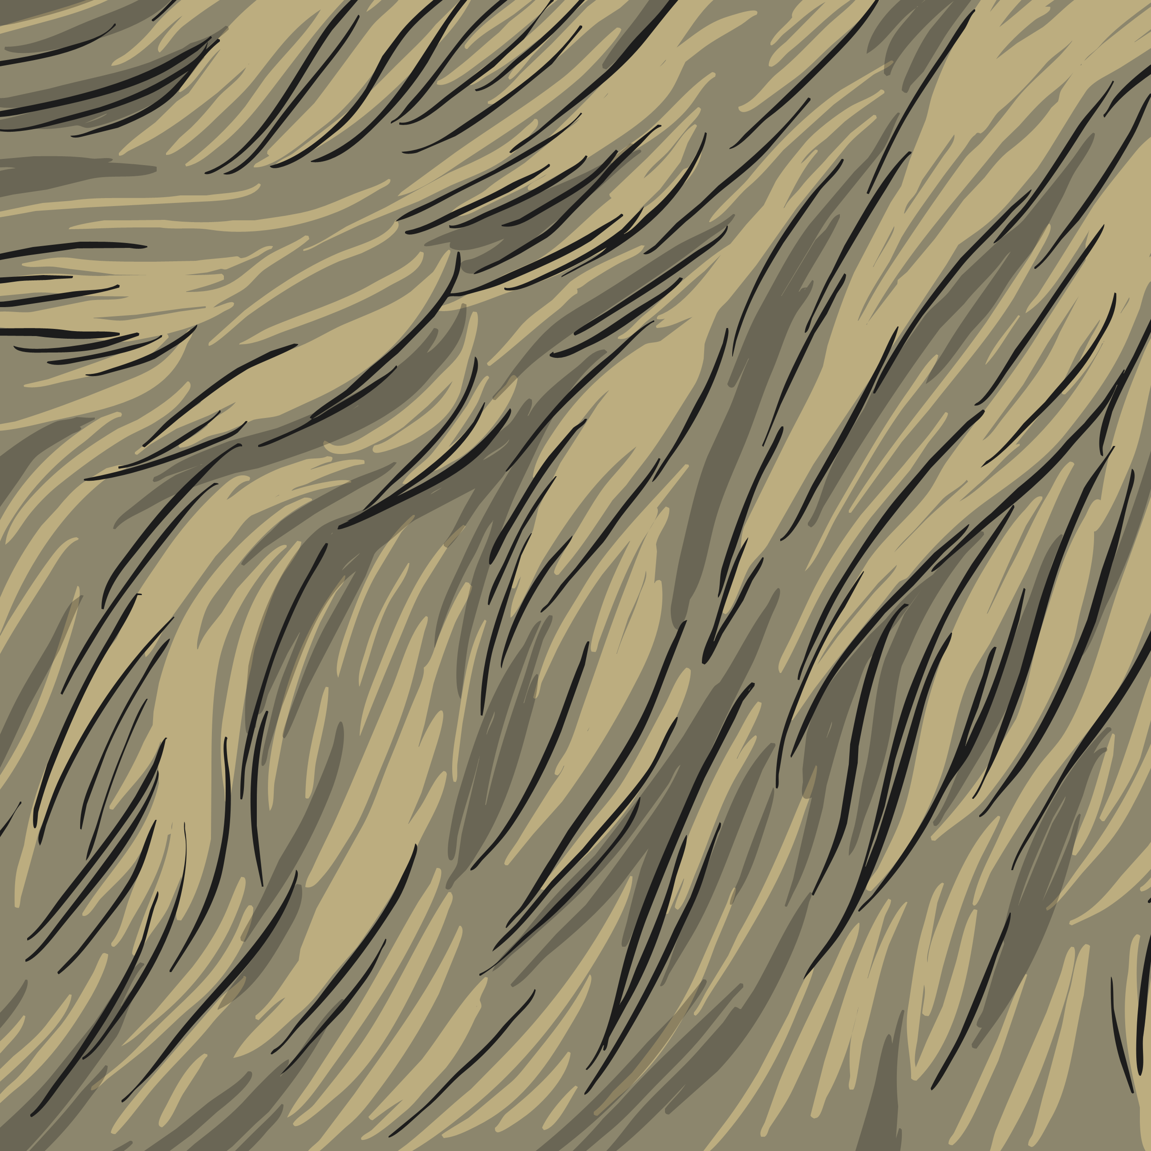
Creating a Monster
What is covering the monster’s body?
Does it have fur?
Has it got scaly skin?
Is it covered in feathers?

Slide 9
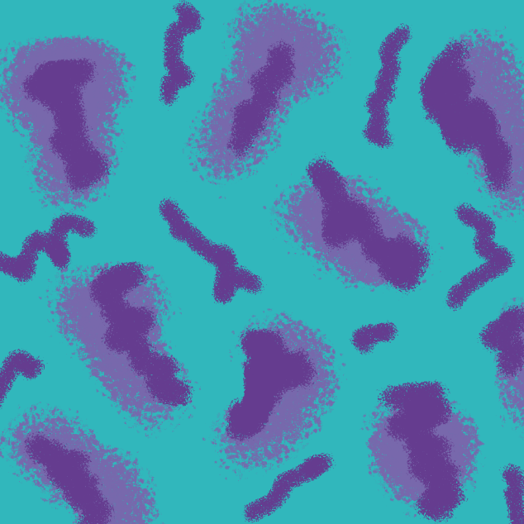

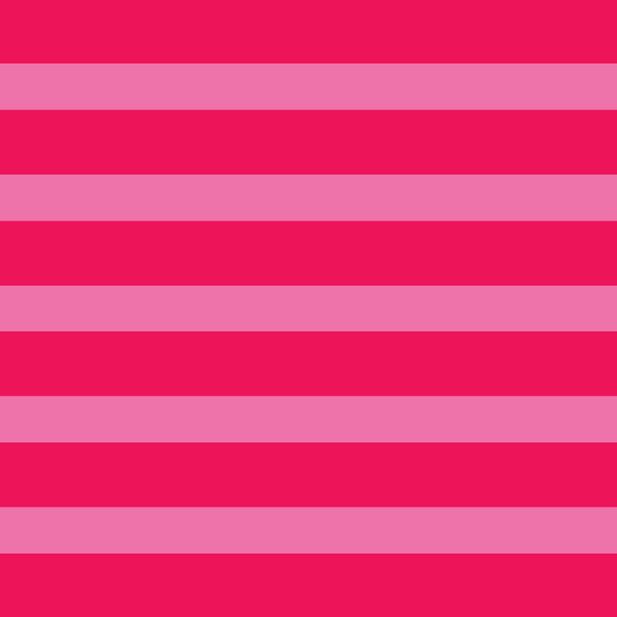
Creating a Monster
What colour shall we make the monster?
Does it have any patches of other colours?
Does it have any spots, stripes or patterns?

Slide 10
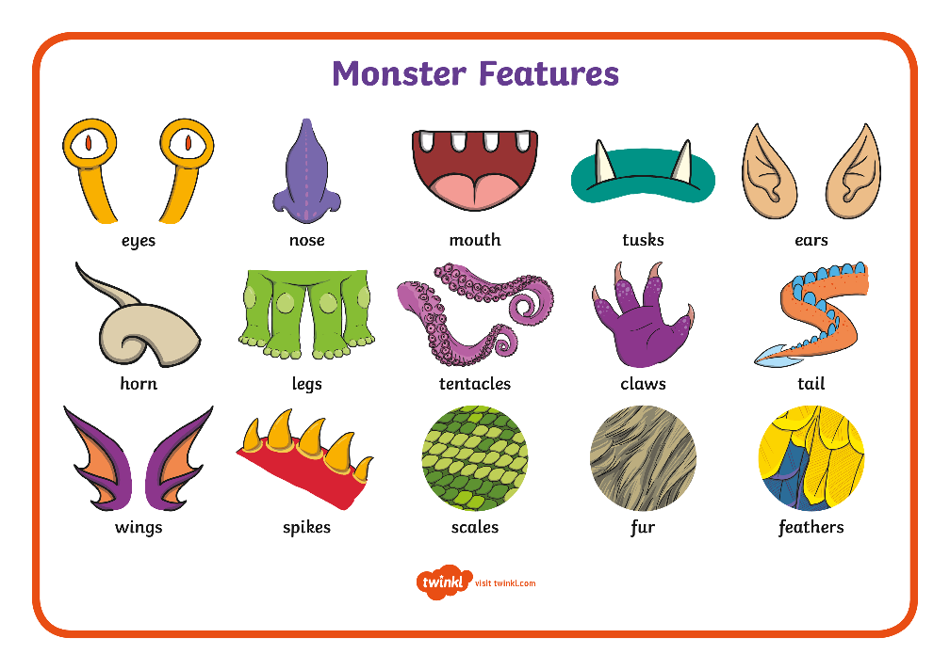
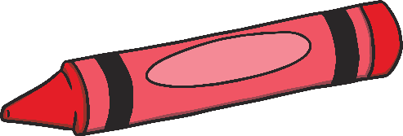
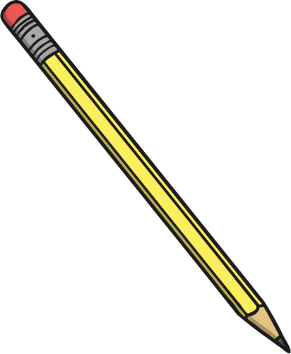

Draw Your Monster
Now it’s your turn to create your very own monster!
Decide on the size and shape of your monster.
Then, add the features.
Finally, choose the colours to complete your creation.
Draw your own monster in your home learning book.
You will need it tomorrow!

Slide 11

Describing a Monster
Let’s think about how we would describe our new monster.
What words or phrases could we use to describe it?
What adjectives would help us?
Think about these things:
size
colour
personality
shape
features
adjective – a describing word, e.g. huge, kind, green, excited
Add adjectives to your monster design.

