Slide 2
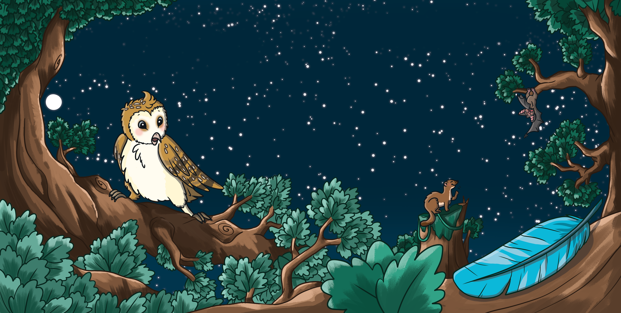
The Mystery Feather
Otis Owl finds a mystery feather.
He has never seen a bird with shiny blue feathers before.
He decides to try to find out where the feather came from.

Slide 3
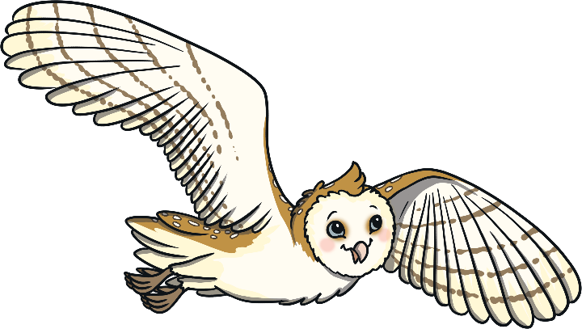
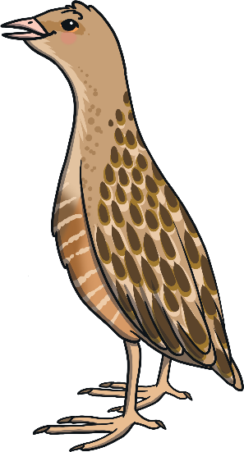
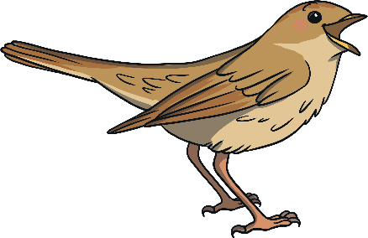
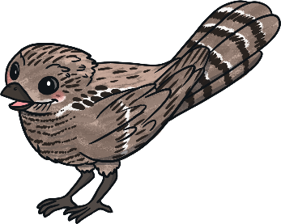
The Mystery Feather
Otis’s friends try to help him find the bird with blue feathers.
Together, they decide to make a poster!

Slide 4


Persuasive Posters
Mystery Feather Found
Have you seen a bird with
shiny blue feathers?
Let’s read the poster together.
What do you think the poster is trying to tell us or make us do?
Tell Otis Owl right away.
We have found a beautiful blue feather that must belong to a brilliant bird.
We would love to find them and become friends.
Would you like to meet an amazing new bird?
Keep your eyes peeled.
How wonderful it would be
to solve this mystery!

Slide 5
Persuasive Posters
Mystery Feather Found
Have you seen a bird with
shiny blue feathers?
The poster is using different types of sentences to persuade us to help find the bird that Otis is looking for.
Tell Otis Owl right away.
We have found a beautiful blue feather that must belong to a brilliant bird.
We would love to find them and become friends.
Would you like to meet an amazing new bird?
Keep your eyes peeled.
How wonderful it would be
to solve this mystery!

Slide 6
Types of Sentences
Statements
Statements are sentences which tell you something, like a fact. They should contain a verb, a noun and usually end with a full stop.
Birds have feathers.
In a persuasive poster, the statement might tell the reader how
brilliant something is.
Robins have beautiful bright red feathers on their chests.

Slide 7
Types of Sentences
Questions
Questions are sentences that ask you something. They usually end with a question mark.
Do you like birds?
A persuasive poster might ask a question that sounds like we should give one obvious answer, usually yes or no.
Can you think of anything more beautiful than a majestic swan?

Slide 8
Types of Sentences
Commands
Commands are sentences that tell you to do something. They are found in instructions and start with an imperative verb (bossy word).
Listen to the birds singing.
In a persuasive poster, the command might be telling us to do
or buy something.
Come and join us on a bird-spotting adventure today.

Slide 9
Types of Sentences
Exclamations
An exclamation is a sentence beginning with ‘What’ or ‘How’. It is a full sentence, including a verb, which ends with an exclamation mark.
What a lovely bird this is!
In a persuasive poster, the exclamation sentence might be used to make it seem like the writer truly thinks something is amazing.
What incredible birds barn owls are!
How fantastic it would be to see a barn owl in the wild!

Slide 10
Types of Sentences
Mystery Feather Found
Can you spot the different types of sentences in
the poster?
Statement
Question
Command
Exclamation
Talk to your partner.
Have you seen a bird with
shiny blue feathers?
Tell Otis Owl right away.
We have found a beautiful blue feather that must belong to a brilliant bird.
We would love to find them and become friends.
Would you like to meet an amazing new bird?
Keep your eyes peeled.
How wonderful it would be
to solve this mystery!

Slide 11
Types of Sentences
Mystery Feather Found
Question
Have you seen a bird with
shiny blue feathers?
Command
Tell Otis Owl right away.
We have found a beautiful blue feather that must belong to a brilliant bird.
We would love to find them and become friends.
Statement
Statement
Question
Would you like to meet an amazing new bird?
Keep your eyes peeled.
How wonderful it would be
to solve this mystery!
Command
Exclamation

Slide 12

Your task today…
Year 1- Read through the story again.
Spot the statements.
Write out 3 in your home learning book.
Year 2- Read through the story again.
Spot the statements.
Write out 4 in your home learning book.
Now write out a question, a command and exclamation from the story or write your own.
Use the help sheet to remember which is which!

