Slide 2
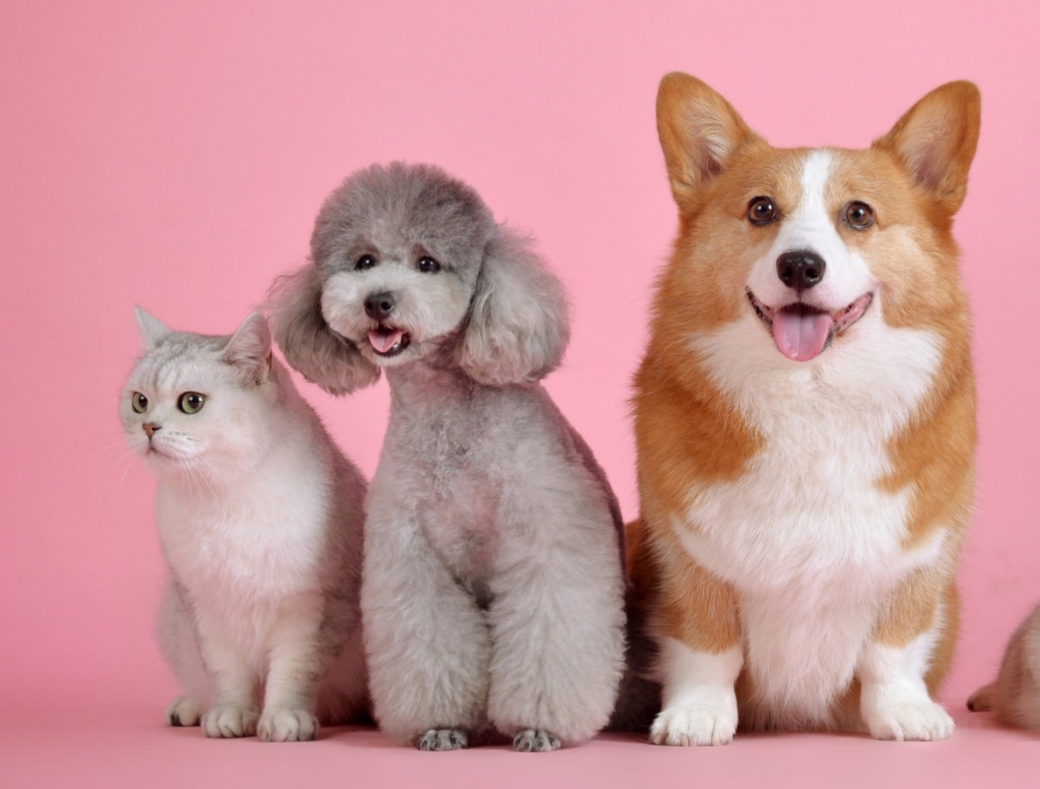

Pets
A pet is a type of animal that usually lives with people in a house. People have lots of different animals as pets!
Pets need lots of love
and special care.
Can you name any animals that can be pets?

Slide 3
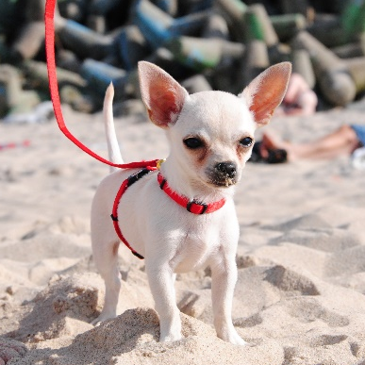

Dogs
There are lots of different types of dogs in the world! They range from very small, like a Chihuahua…
to very big, like a Great Dane!
Dogs take lots of time and patience to train and look after. They need lots of walks and exercise, and lots of toys to keep them from getting bored. Most dogs are very friendly and like to be around people.
Would you like to have a pet dog?

Slide 4
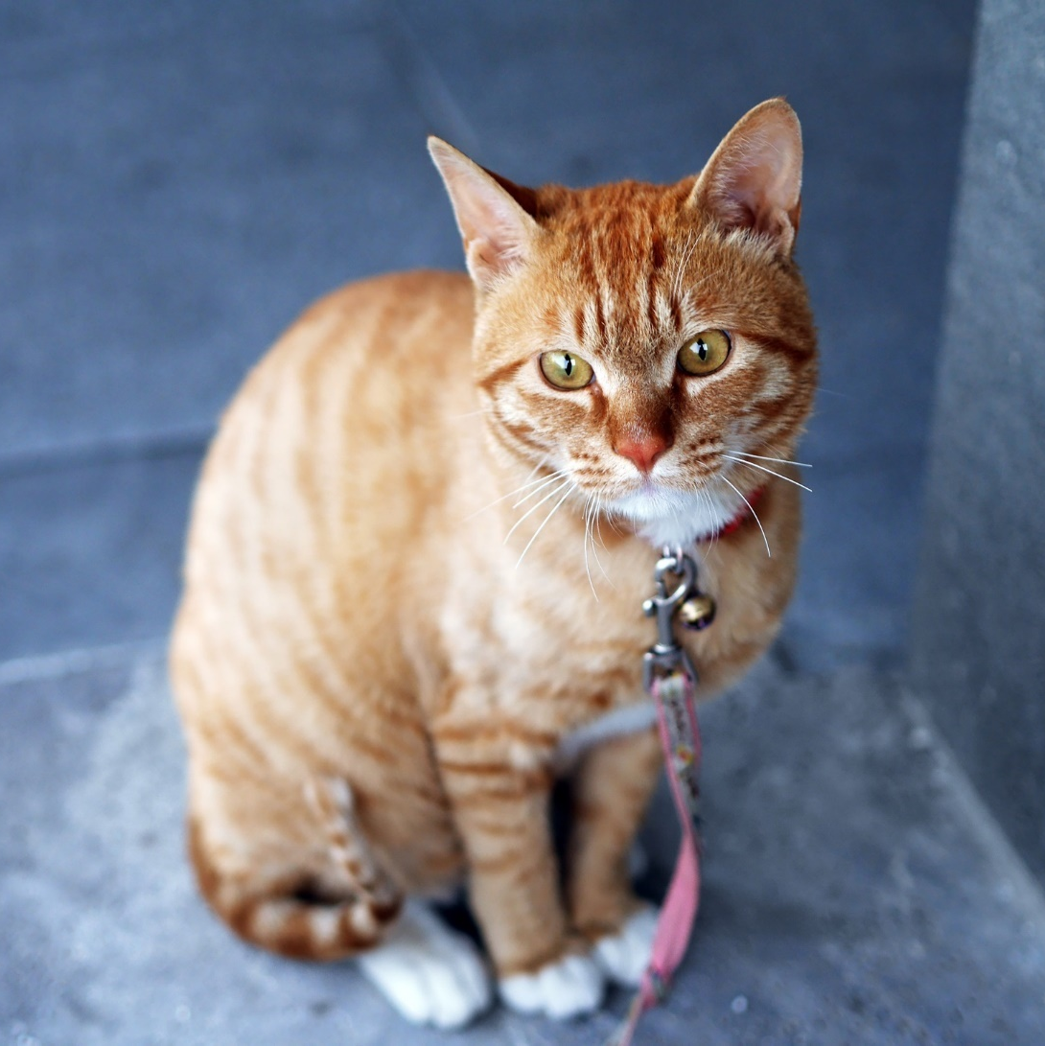
Cats
Cats are usually quiet pets. They love to play with toys. Cats like to be stroked but you need to be gentle
with them.
Cats like to have lots of space so some people let their cats out of their house to go outside on their own.
Cats mostly eat dry or wet food which is made of meat.
Would you like to have a pet cat?

Slide 5
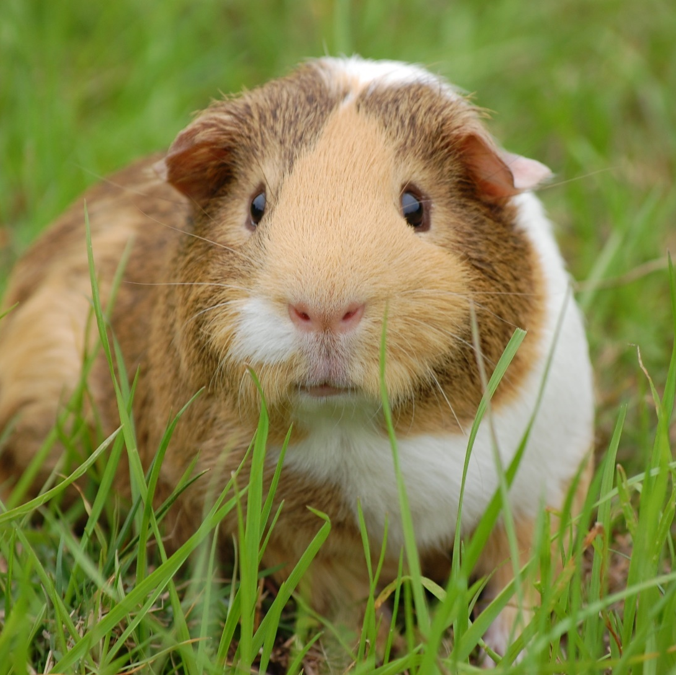
Guinea Pigs
Guinea pigs are small animals. They are similar to hamsters, mice and rats. Guinea pigs can get scared around loud noises so you need to be quiet and gentle with them.
Guinea pigs usually live in a hutch outside. They need straw or hay to eat and also to sleep in. They also like to eat fruits and vegetables, such as peppers and spinach.
Would you like to have a pet guinea pig?

Slide 6
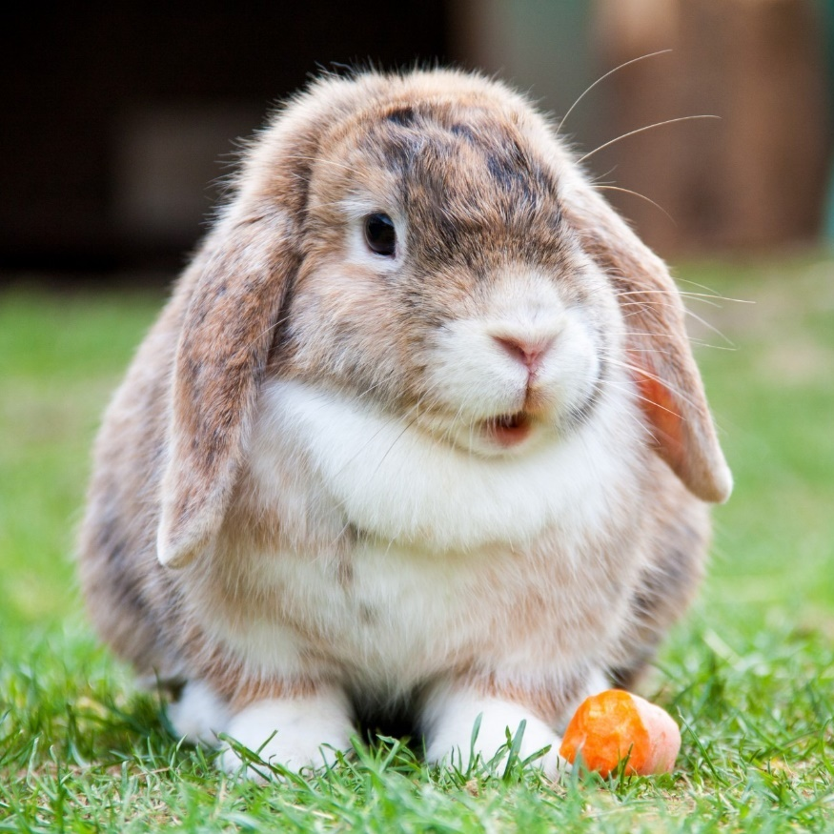
Rabbits
Rabbits are very popular pets. Many rabbits like to be stroked and some will let you pick them up. They like being with other rabbits so it’s best to keep two rabbits together in the same hutch.
They need lots of space to hop around and stretch out. Some people let their rabbits out in their garden. Rabbits like lots of fresh vegetables to eat, such as cabbage and broccoli.
Would you like to have a pet rabbit?

Slide 7
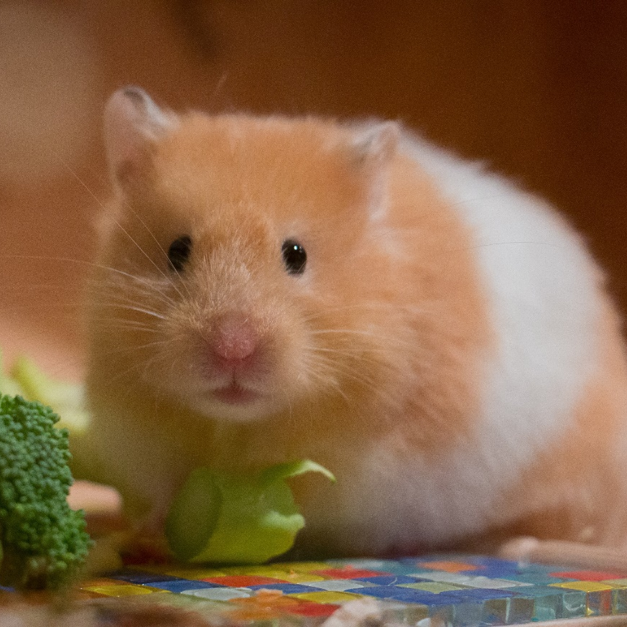
Hamsters
Hamsters are small animals. They are usually kept in a cage with sawdust and hay for their bed. Some hamster cages have tunnels and wheels for the hamster to run around in. This helps to stop them getting bored.
Hamsters like to eat seeds, cereals and fresh fruits, such as apples. They often keep their food in ‘pouches’ in their cheeks so they can move it from place to place.
Would you like to have a pet hamster?

Slide 8
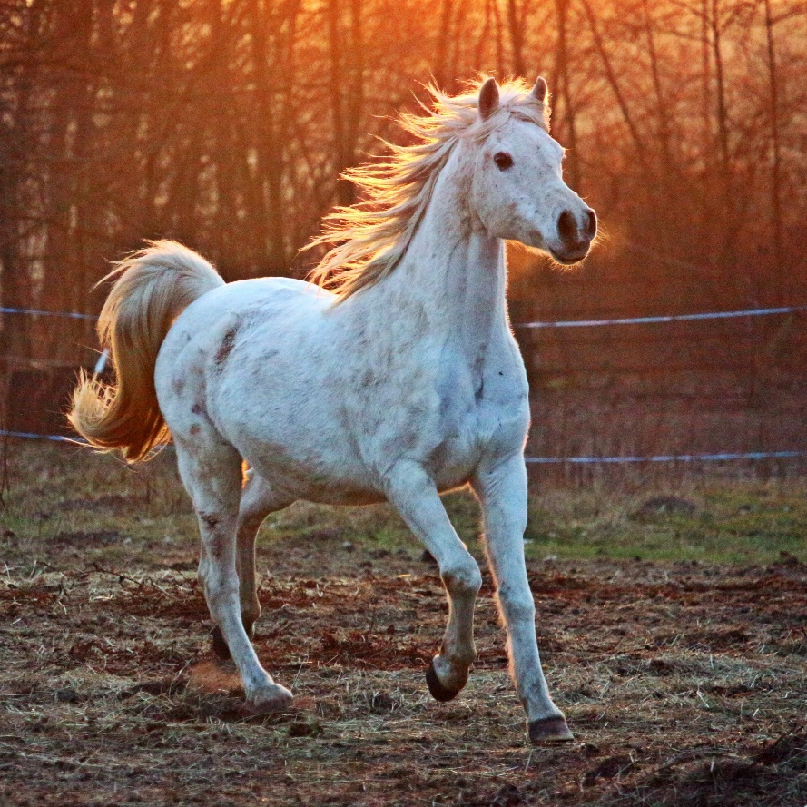
Horses
Horses need lots of special care. They are big animals so they need lots of space to rest and run around in.
Horses are usually kept in special homes outside called stables. Horses need to be groomed regularly and checked to make sure they stay healthy, especially their hooves.
Horses eat mostly grass and hay. They can also eat some fruits and vegetables as snacks, such as apples and carrots.
Would you like to have a pet horse?

Slide 9
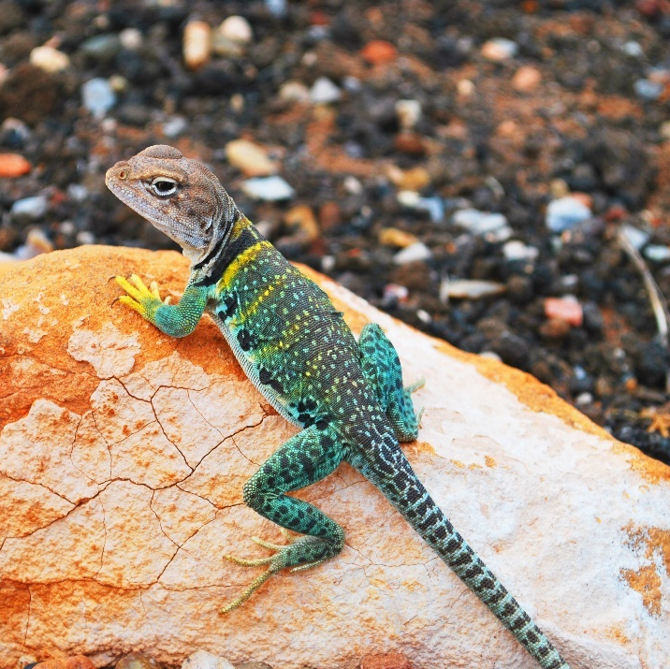
Lizards
There are lots of different types of lizards that people keep as pets, such as geckos and bearded dragons.
Lizards need very special care. They are usually kept in a glass tank. Some lizards need special heat lamps to keep them warm. They also need lots of plants in their tank to give them somewhere to hide.
Lizards eat live insects, such as crickets and locusts.
Would you like to have a pet lizard?

Slide 10
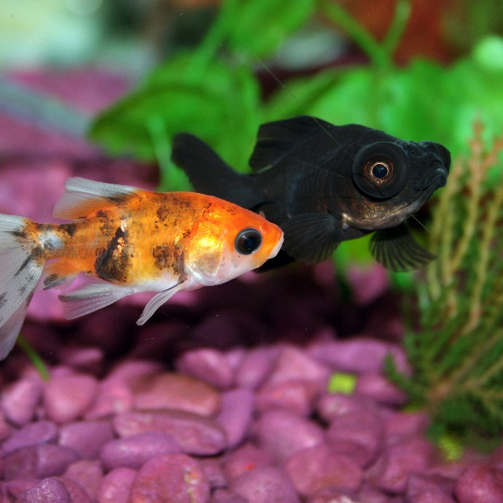
Fish
Fish are very popular pets. They are good for people who don’t have enough space at home to have bigger pets, such as dogs
and cats.
Fish need to be kept in a tank called an aquarium. The tanks need to be cleaned often so that the water stays fresh and the fish stay healthy. Some fish, such as tropical fish, need a special heater in their tank to keep the water warm. They may also need salt water, rather than fresh water.
Fish eat special flakes or pellets you can buy from pet shops.
Would you like to have a pet fish?

Slide 11
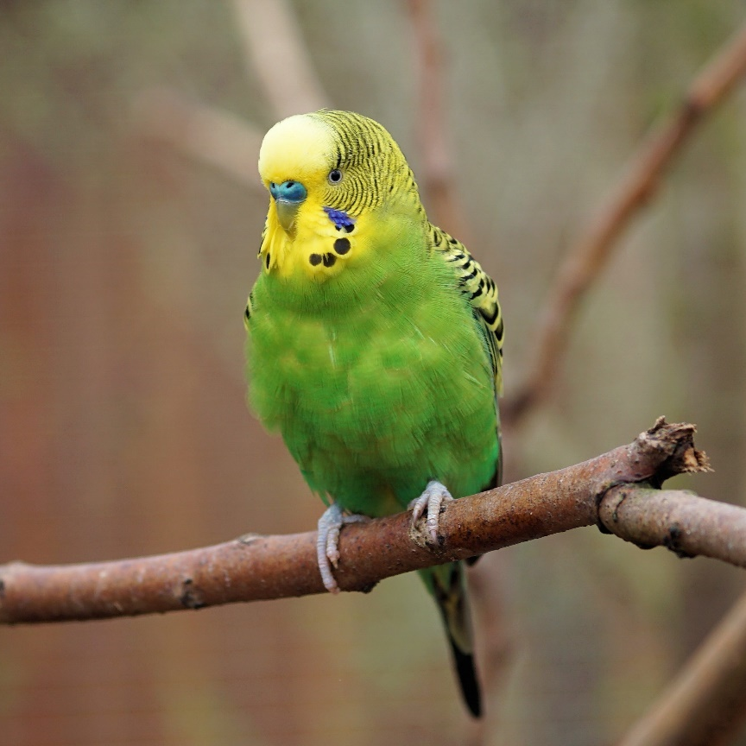
Birds
There are lots of different birds that can be kept as pets, such as parrots and cockatiels.
Some birds can be kept outside in a big cage called an aviary. Other birds need to be kept indoors, but they still need plenty of space. Indoor birds need a large cage and space to fly around to stretch their wings.
Birds such as parrots can eat special bird food you can buy, but they also like seeds and fruits.
Would you like to have a pet bird?

Slide 12
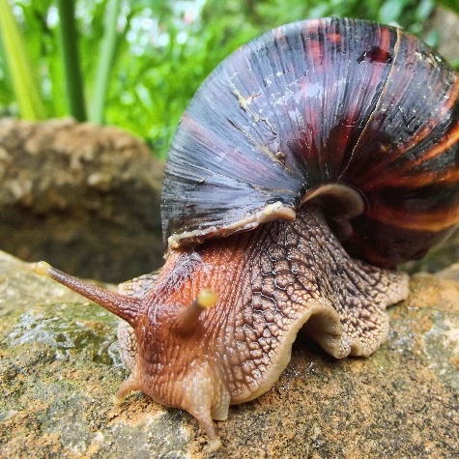
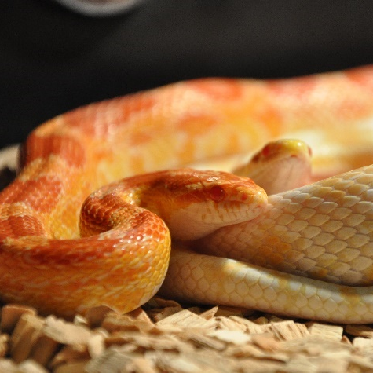
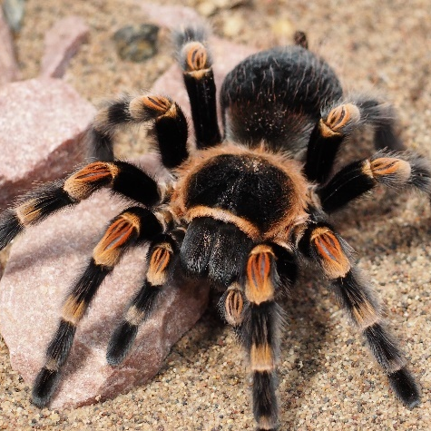
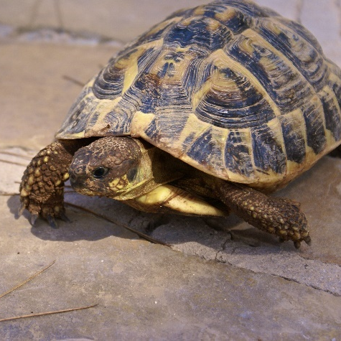
Unusual Pets
Some people have pets that are more unusual. These include giant African land snails, snakes, spiders/tarantulas, and tortoises.
These animals need lots of special care to keep them happy and healthy.
African land snail
snake
tarantula
tortoise
Would you like any of theses animals as a pet?

