Slide 1
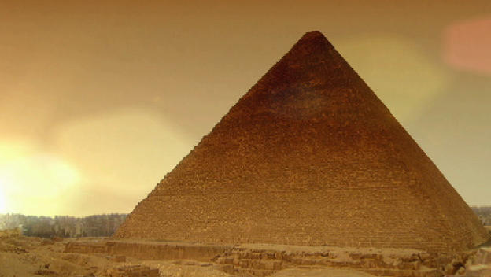
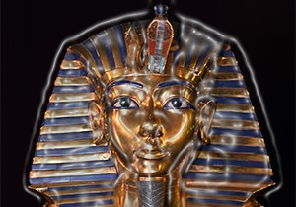
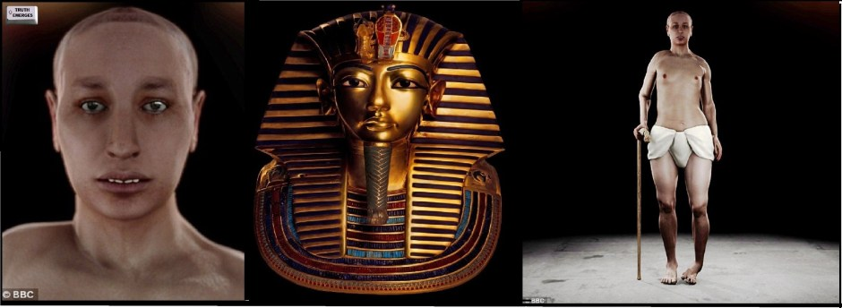
Ancient Egypt
By Aiden Jeffcoat

Slide 2
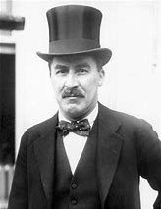
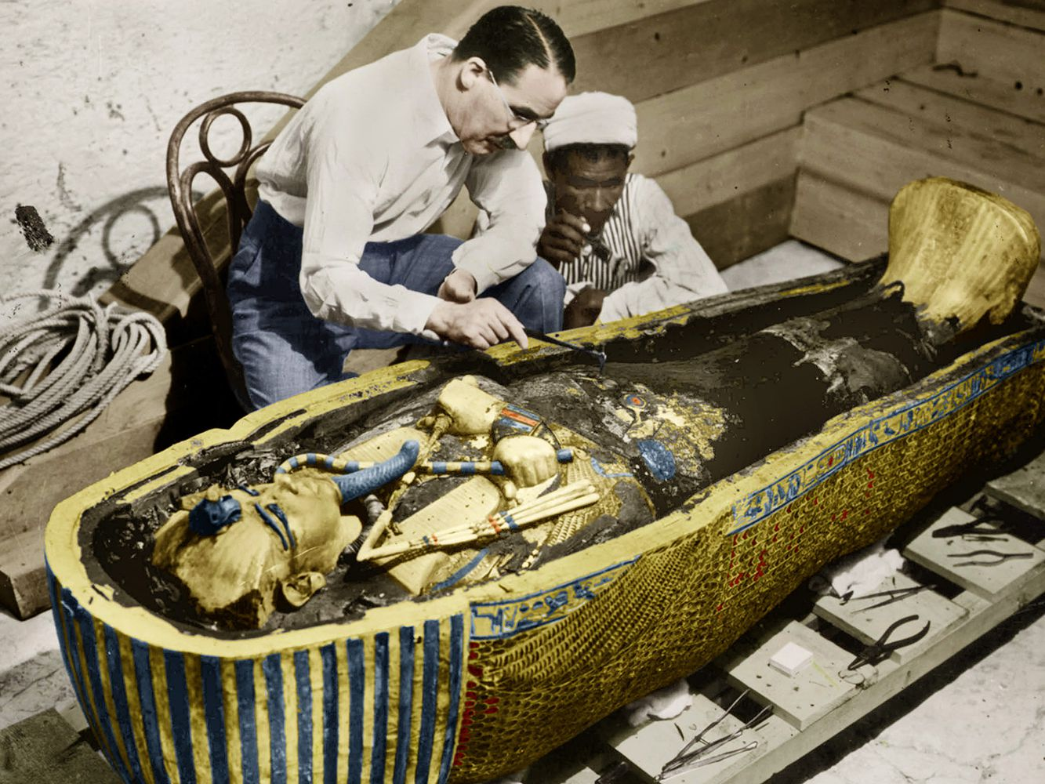
Tutankhamun’s Tomb
Howard Carter was 48 when he discovered the Tomb. Carter discovered the tomb in 1922.
King Tut was nicknamed the Boy King because he began his reign when he was only nine years old! Tutankhamun died when he was only 18, and his body was mummified, which is how the ancient Egyptians preserved their dead.
Tutankhamun, Egyptological pronunciation Tutankhamen, was an ancient Egyptian pharaoh who was the last of his royal family to rule during the end of the 18th dynasty during the New Kingdom of Egyptian history. His father was the pharaoh Akhenaten, believed to be the mummy found in the tomb.

Slide 3
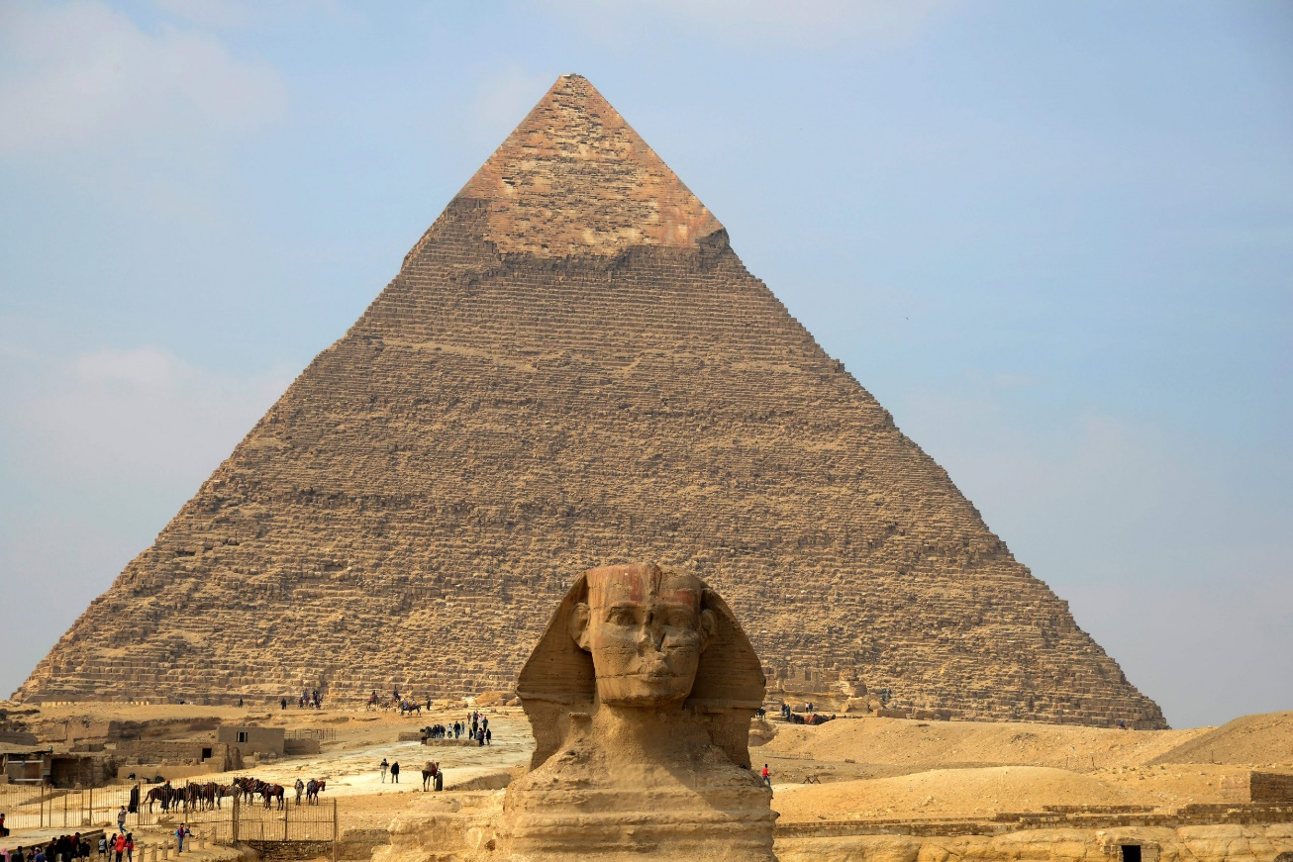
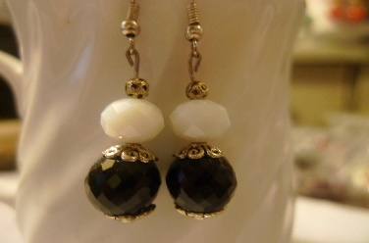



Inside the Tomb and the Sphinx
About the Sphinx
The sphinx is a mythical creature who Egyptians believed in. A sphinx (or sphynx) is a creature with the body of a lion and the head of a human, with some variations. It is a prominent mythological figure in Egyptian, Asian, and Greek mythology.
Inside of the Tomb
Men, women, and children routinely adorned themselves with the best jewellery they could afford in an assortment of styles. An abundance of jewellery indicated that the gods were happy with the wearer and was thus blessing him or her.
The dead were entombed with their own jewellery as well as items belonging to family members, which helped ensure their success in the afterlife. Most ancient Eqyptians wore collar pieces which ranged from extravagant to simple, depending on the status of the wearer, and wealthier Egyptians would often have their most elaborate collar pieces entombed with them.

Slide 4
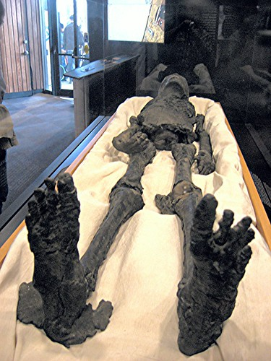
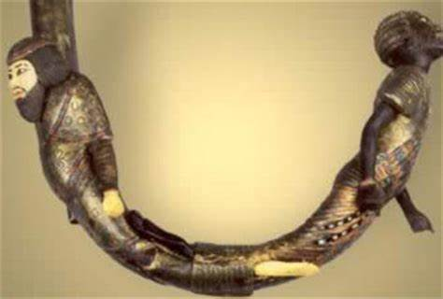
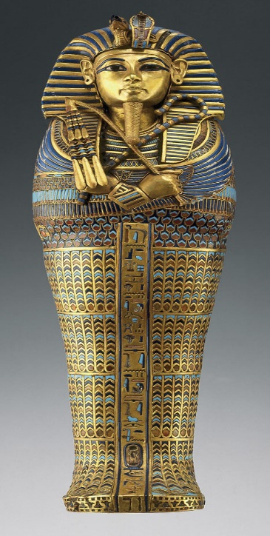
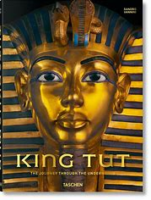
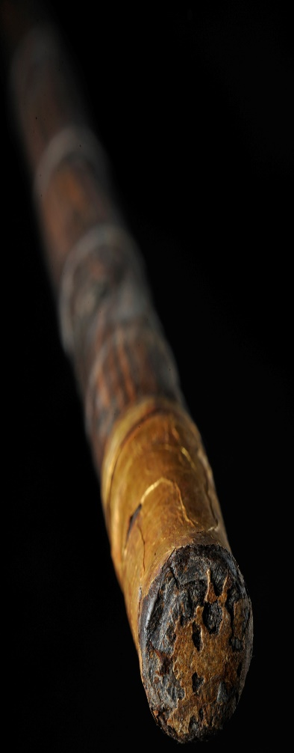
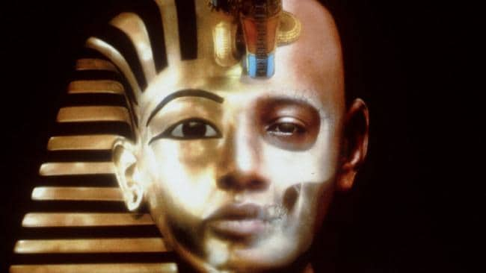
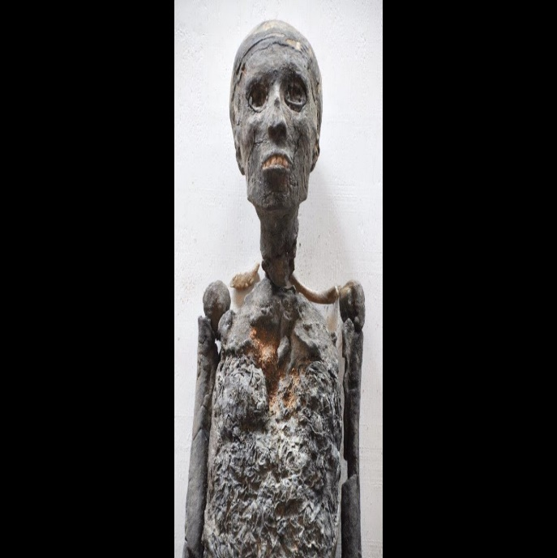
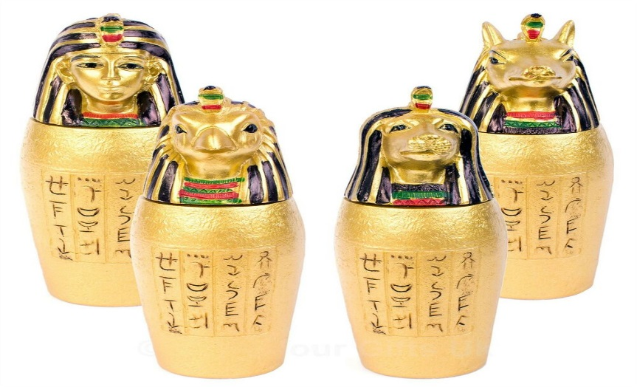

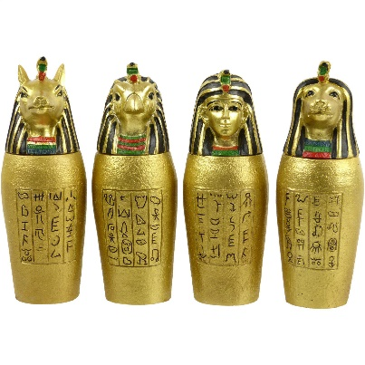
Picture Gallery

Slide 5
THE END!
Comments 3,900

