Slide 1
Design and then make an obstacle course using things from your house or garden. You may want to create a circuit training area.
09.06.20
Why not share your work on Seesaw?

Slide 2
Design a positive thinking cap that you might wear when you are in the classroom. Please include labels and explanations for why you have chosen your design features.
09.06.20
Can you upload a picture of your work on to Seesaw?

Slide 3
Draw your own portrait. You will need a mirror and you will need to look very closely at the detail of your face.
Do you remember doing something similar in class? Think about the scale of your face and remember to sketch what you see.
Follow the steps on the next page to help prompt you.
09.06.20
I would love to see what you have come up with! Why not upload it!

Slide 4
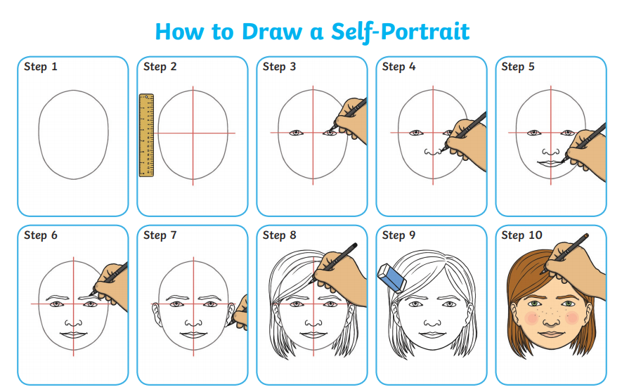

Slide 5
Daily Seesaw activity
What’s an invertebrate?
Use the information on Seesaw to go on an invertebrate hunt in your outside area.
Remember to take pictures!
09.06.20

