Slide 1
Happiness is…..
I would like you to write a poem that explains what happiness is to you.
What does it mean to be happy?
How do you feel inside?
What makes you happy?
Maybe you could use some of the poses from your yoga session yesterday to help you when you recite your poem? Or maybe you could create your own poses?
11.06.20
Why not share your work on Seesaw?

Slide 2
Draw a strength family tree. You might want to use the example on the next slide to help you, or you may choose to draw your own.
Remember to list all of the things that each person in your family is good at.
How have these strengths helped you to overcome challenges together?
11.06.20
Can you upload a picture of your work on to Seesaw?

Slide 3
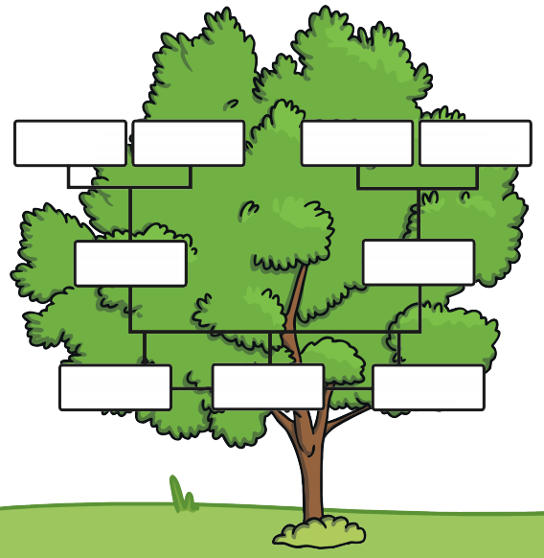

Slide 4
Write a letter to one of your classmates to check that they are well and see how they are doing.
Why not choose someone who you have not been in contact with since we have been working from home?
11.06.20
I would love to see what you have come up with! Why not upload it!

Slide 5
Daily Seesaw activity
It’s competition time for Bolton and Byland!
Have a look on Seesaw to see what challenge Miss Jackson and I have set for you…
Remember to take pictures!
11.06.20

