Slide 1
Find and turn something from your home in to a musical instrument. You may want to use recycled items to make your own instrument. It is entirely up to you.
08.06.20
Using the link below, listen to the piece of music and try and use your instrument to accompany it.
https://www.youtube.com/watch?v=tRRWzlnLFOU&list=PLTzwvDVC5oBYzoxoPGmjyfMLPI-oslI87&index=1
Can you write or draw your beats to show when you need to play?
Why not share your work on Seesaw?

Slide 2
Using the pdf that has been uploaded, try to think of as many positive things as you can that have come out of lockdown.
Have you learned a new skill? Have you tried a different food? Perhaps you have finished a really good book!
08.06.20
Can you upload a picture of your work on to Seesaw?

Slide 3
Get all of your coloured pens and pencils (or maybe your computer) and create a Positive Mental Health poster. Try to include an inspirational quote. Have a look at the examples on the next slide.
Have you thought about:
What is positive mental health?
What can people do to have healthy?
Why is it important?
08.06.20
I would love to see what you have come up with! Why not upload it!

Slide 4
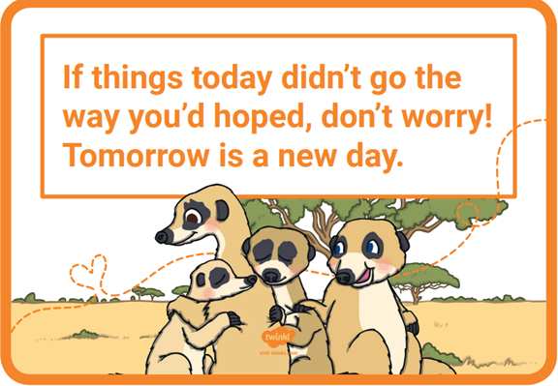
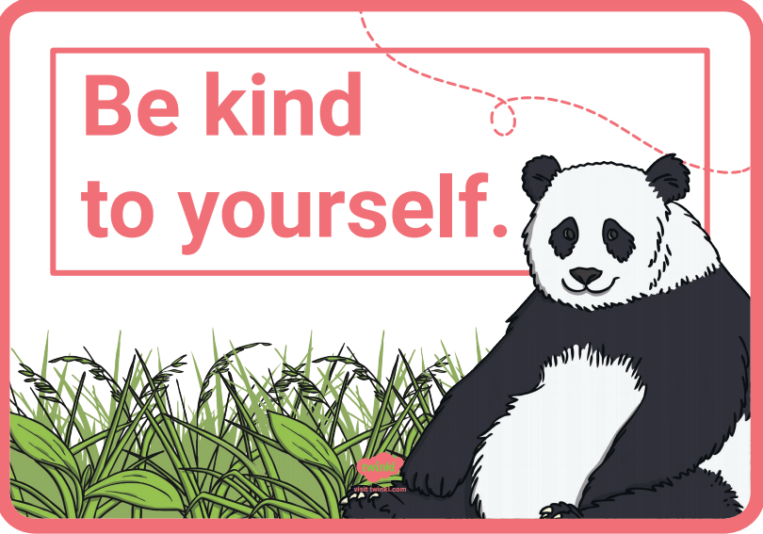
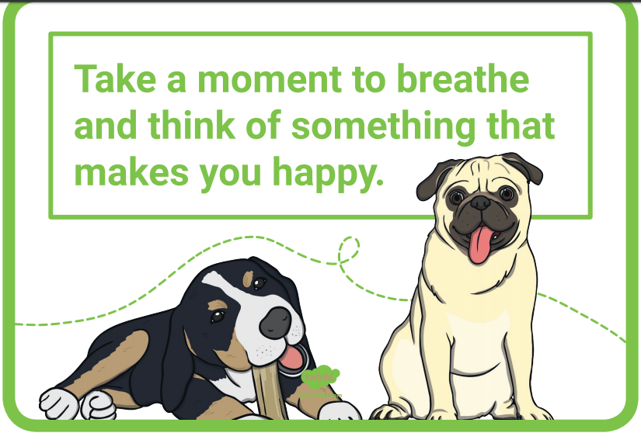
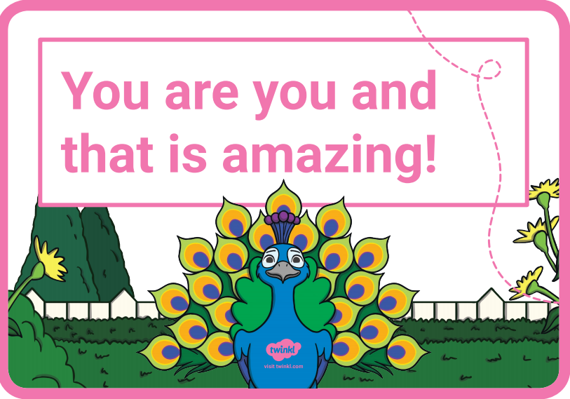

Slide 5
Daily Seesaw activity
Make a cloud in a jar
Have a look online to see what you need to do to make a cloud in a jar.
Remember to take pictures!
08.06.20

