Slide 1
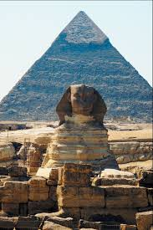
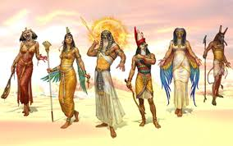
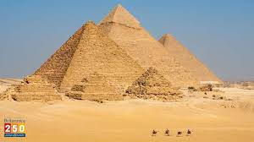
Egyptians
By Matilda and Noah

Slide 2
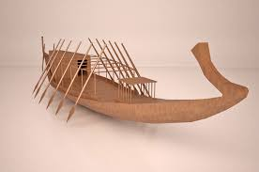
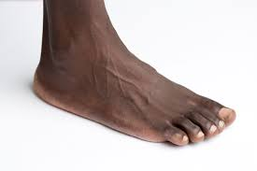
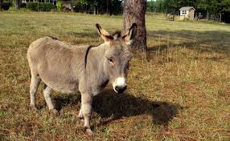
Egyptian transport
Did you know Ancient Egyptians would travel on donkeys, by boat and by foot
Kings would cruise on the River Nile in customised boats

Slide 3
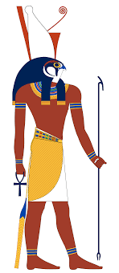
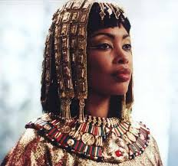
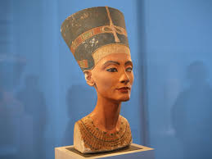
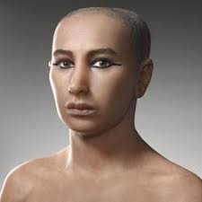
Famous figures
There are many famous figures such as Cleopatra, King Tut, Nefiti and Horus

Slide 4
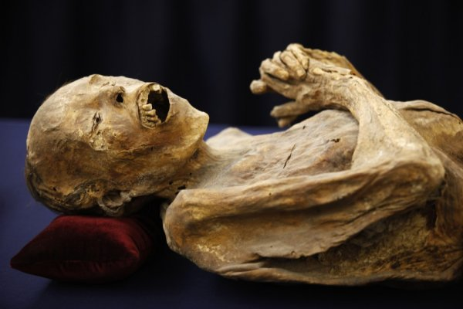
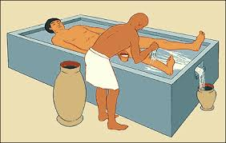
Mummification
Did you know mummification took hours to do
People called embalmers would mummify the dead body

Slide 5
How to mummify a body
Firstly, rinse the body in water , salt and wine.
Then, remove all of the organs excepted the heart because it would make the pharaoh happy in the afterlife.
Next, place the organs in canopic jars and pull the brain out of the nose .
To pull the brain out, get a long hook and stir it in to mush.
After, they put the body in a bath of salt and leave it for 40 days .
Then, they put oil on the body to make it elastic.
Afterwards , they carefully wrap the body up with linen bandages.
Next, they put amulets in between the layers of linen.

Slide 6
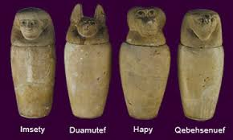
Canopic jars
Did you know there were 4 canopic jars which were called IMESTY HAPY DUAMUTEF and QEBEHSENUEF. These were used to keep organs well protected. Did you know they would not take the heart out as they believed they needed a heart for a good and happy afterlife

Slide 7
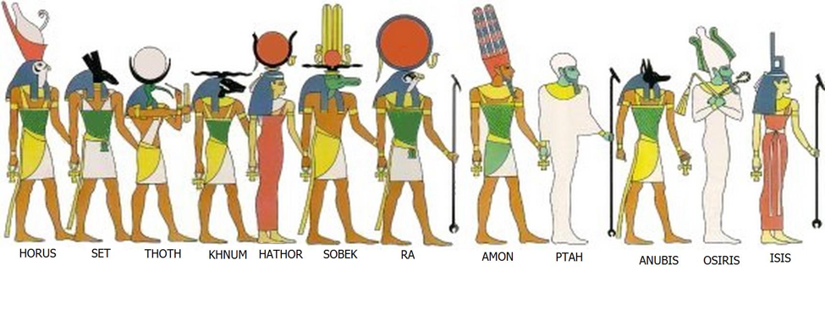
Egyptian gods and goddesses
Egyptians believed in many gods and got to pick who they worshipped
When a king died they would become a god

Slide 8
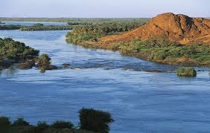
River Nile
Did you know the River Nile was used for many things, for example Egyptians and animals could drink the water

