Slide 1
Story Writing – Day four
Each day, I will give you a picture prompt which you need to try and add in to your plot.
Today, use the last two pictures on the following slide to help you to write the ending to your story.
Again, try not to rush your writing. I don’t want to see….
She saw the garden. She saw flowers. The end.

Slide 2
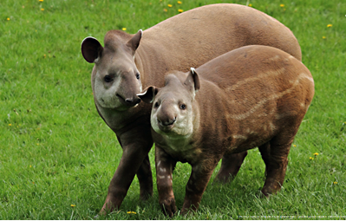
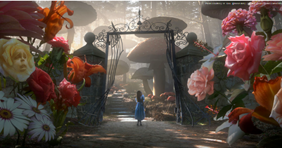
Have you used: fronted adverbials, expanded noun phrases, subordinated conjunctions, alliteration, similes, full sentences and questions?
Challenge yourself by trying to include at least three coordinating conjunctions.

