Slide 1
Anthony Browne - Zoo
Thursday 23rd April 2020
Look at these illustrations which have been taken from Zoo. What do you think the illustrations are trying to tell us?

Slide 2
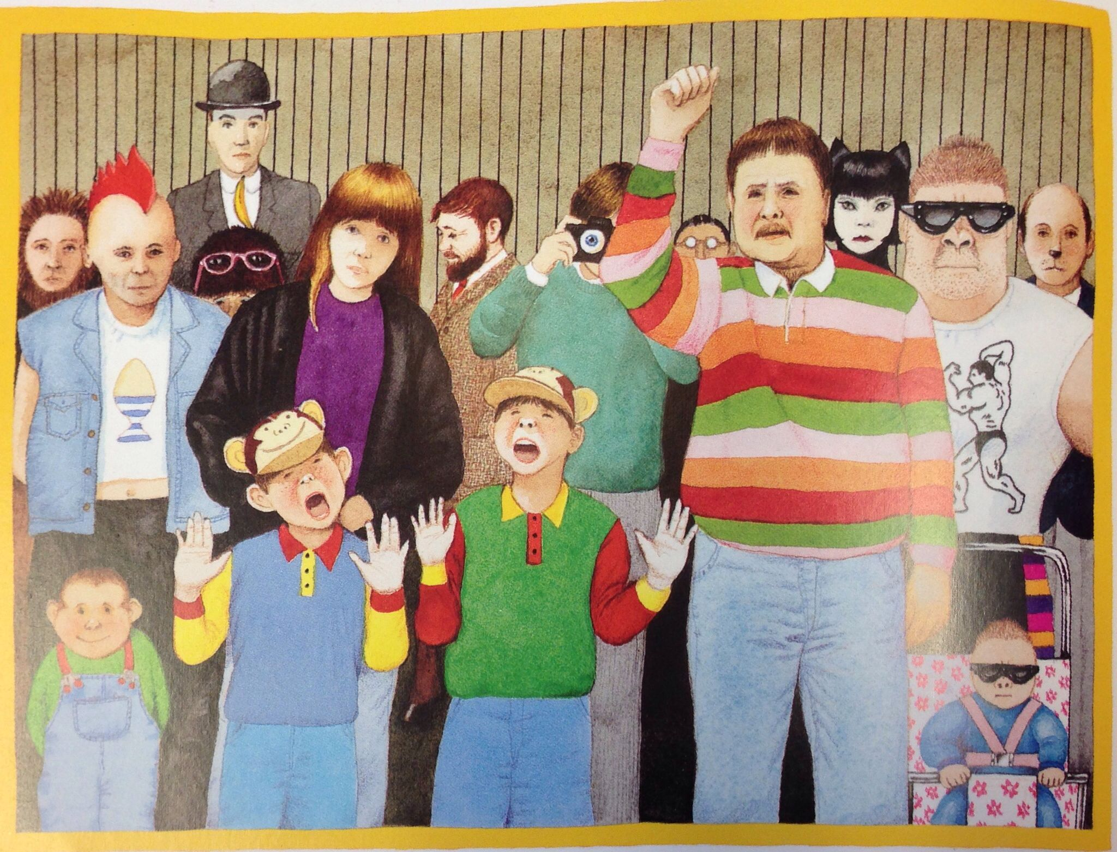

Slide 3
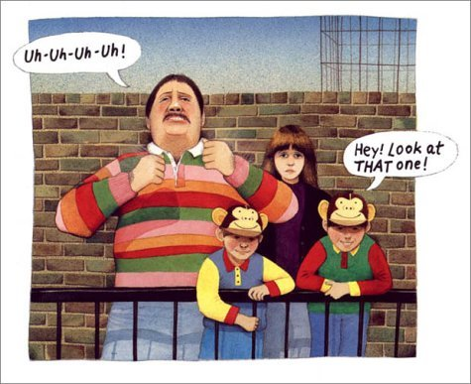

Slide 4
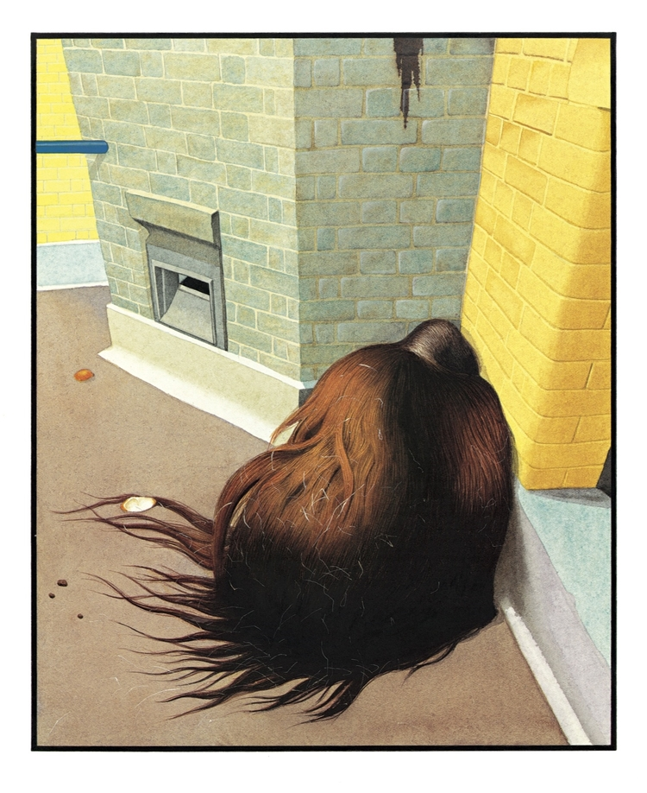

Slide 5


