Slide 1
Story Writing – Day one
This week we are going to focus on story writing. Each day, I will give you a picture prompt which you need to try and add in to your plot.
Today, I would like for you to write your story opener. Think about setting the scene, where you should describe what you can see, smell, hear…
Really pull your writing apart and take your time to give massive amounts of detail so that I can paint the image in my head.

Slide 2
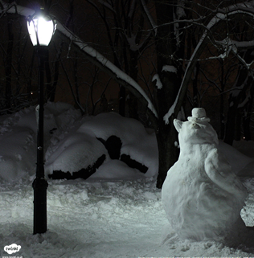
Have you used: fronted adverbials, expanded noun phrases, subordinated conjunctions, alliteration, similes, full sentences and questions?
Challenge yourself by trying to include apostrophes for possession.

