Slide 1
Apostrophes
Why do we use an apostrophe for ‘it’s’?
Why do we use an apostrophe for ‘Mrs Cox’s badge’?
Why do we not use an apostrophe for ‘Miss Liptrot loves cake’?
Whilst we have covered this in class, I thought it would be good to refresh your memory.
Extension – Read through the biography example and see how many of the features you can identify. Don’t worry about answering the reading comprehension questions.

Slide 2
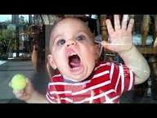
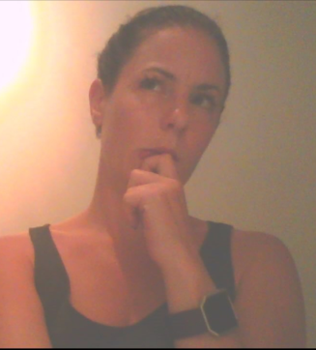
Write as many sentences as you can, using this picture to prompt your imagination.
Try to use:
Apostrophes for contraction (it’s, don’t, can’t)
Apostrophes for possession
I wonder if you could also try to include fronted adverbials, conjunctions and subordinating clauses.

