Slide 1
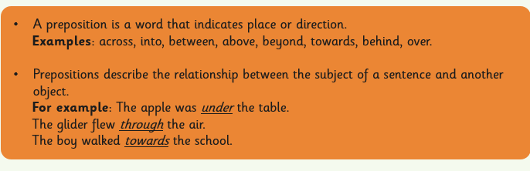
Prepositional Phrases
Friday 1st May 2020
Read through this text and try to write down all of the prepositional phrases that have been used. There are eleven in total!

Slide 2
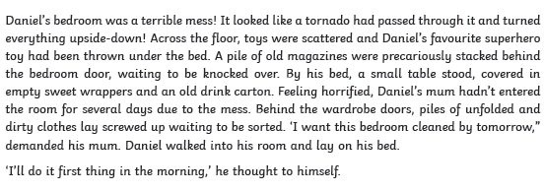
Prepositional Phrases

Slide 3


