Slide 1
Story Writing – Day three
Each day, I will give you a picture prompt which you need to try and add in to your plot.
Today, add a solution to your dilemma, using the picture to prompt you
Try hard not to rush your writing. Rock climbing is incredibly strenuous! I do not want to see you write….
They climbed up the rock.

Slide 2
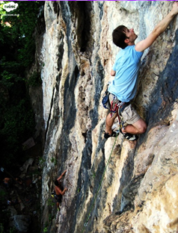
Have you used: fronted adverbials, expanded noun phrases, subordinated conjunctions, alliteration, similes, full sentences and questions?
Challenge yourself by trying to include a synonym for the word ‘hard’.

