Slide 1
Story Writing – Day two
Each day, I will give you a picture prompt which you need to try and add in to your plot.
Today, I would like for you to use the picture on the next slide and add in a dilemma in to your plot. What could possibly have gone wrong?

Slide 2
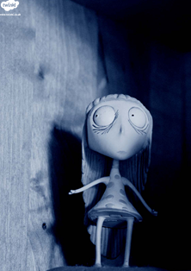
Have you used: fronted adverbials, expanded noun phrases, subordinated conjunctions, alliteration, similes, full sentences and questions?
Challenge yourself by trying to include apostrophes for contraction.

