Slide 1
Well being week
Thursday 11th June 2020

Slide 2
Competition time!!
Right Bolton and Byland! We have devised a challenge!
We would like to find out how many star jumps you can complete in 60 seconds.
Why not record yourself and tell us the total number of star jumps that you have completed. We will then add up the total from both classes and share the results on the school Facebook page.
We bet that you cannot complete more than 500 star jumps combined... prove us wrong :-) :-)
Do you accept our challenge?

Slide 3
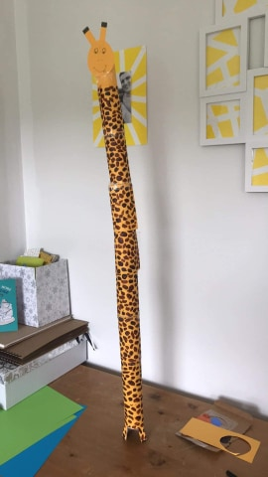
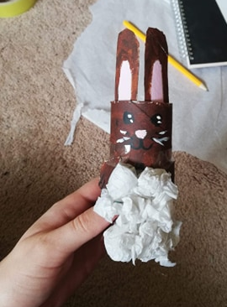
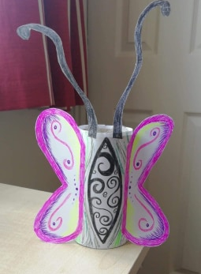
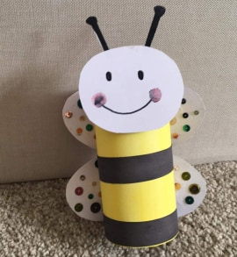
Toilet roll tube challenge
Using at least one toilet roll tube and any other resources you have, create an animal of your choice.
Here are some examples that might give you some inspiration:
Your work will be featured on the school’s Facebook page if you post it on Seesaw.

Slide 4
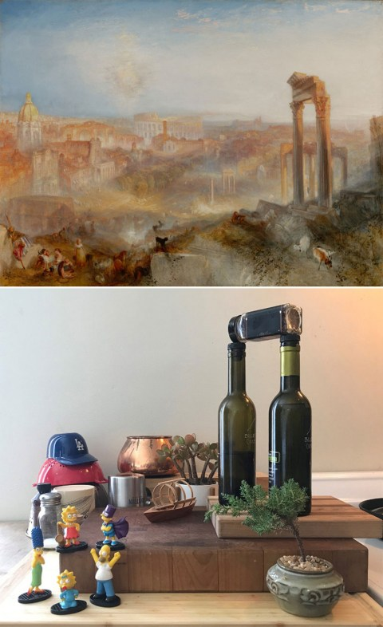
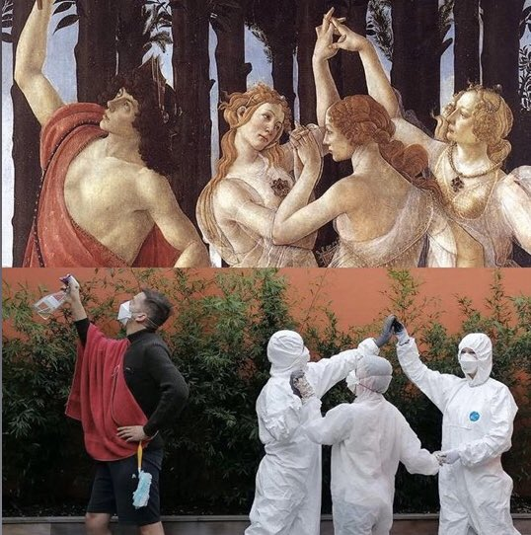
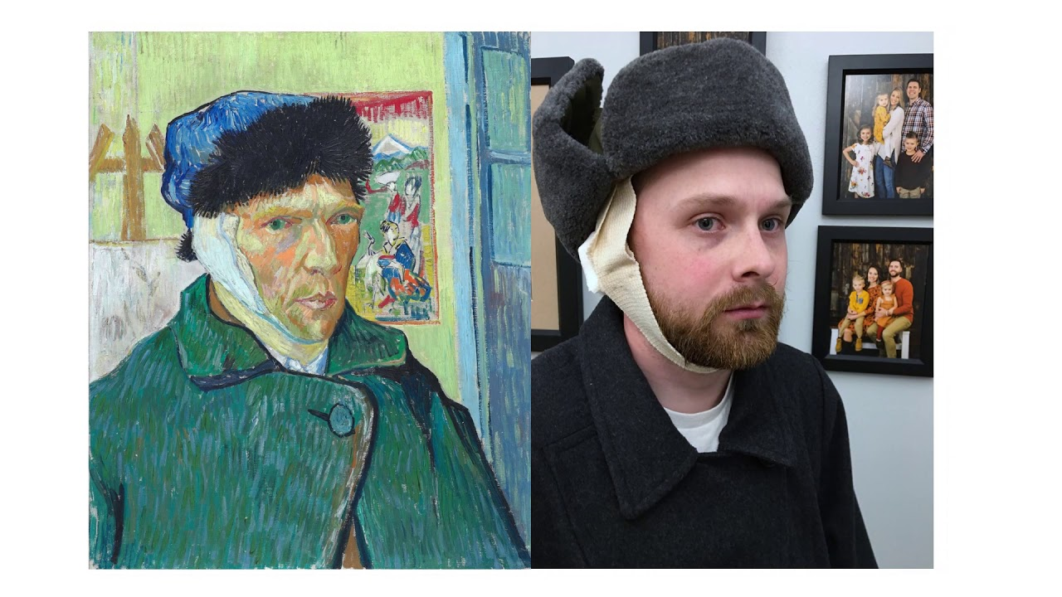
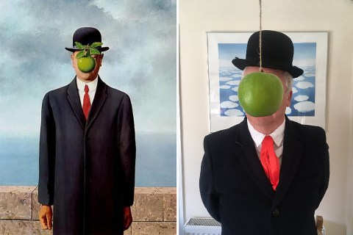
Recreate a famous photograph or painting
Have a go at recreating a famous photograph or painting. Find the image you want to use and try to be as creative as you can in how you reproduce it. Have a look at some examples below. If you want to try to recreate it by painting it or drawing it yourself, you can do that.
Please post both the original and your creation on Seesaw together.

Slide 5
what IS MY FORTUNE?
Create a fortune teller by following the steps in the video.
https://www.youtube.com/watch?v=SAhiIlTxUYA
On the inside layer, you could write fortunes or actions if you want. Such as: do 10 star jumps, try to lick your nose. It’s up to you ☺
Show me how yours works on Seesaw!

