Slide 1
Well being week
Friday 12th June 2020

Slide 2
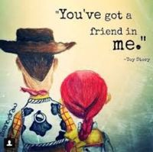
Makaton Song
Here is another Bolton and Byland activity.
We would like you to start learning this song. Have a look at the link.
Why not practice and then record some of the signs that you have learned?
https://www.youtube.com/watch?v=4ikPluPs2xI

Slide 3
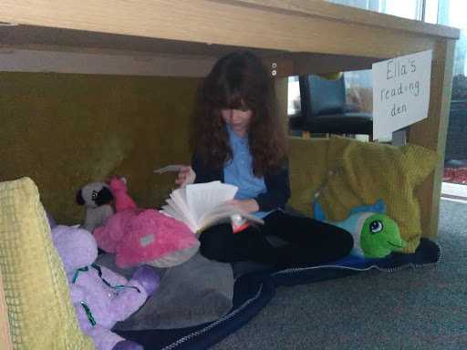
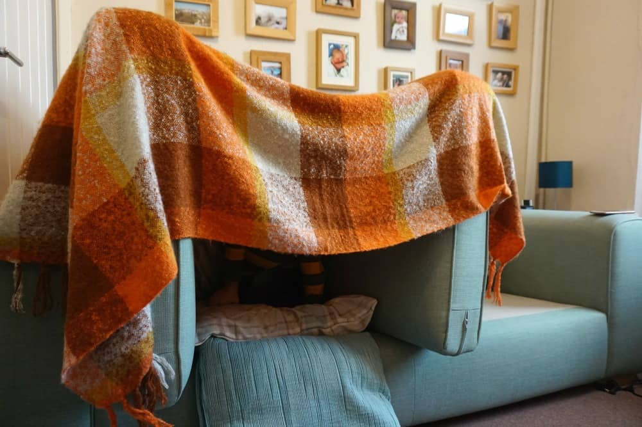
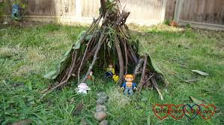
Create a den for a toy
Create the perfect den for one of your toys. You could use sticks outside, cushions, a blanket roof, it’s up to you.
Your toy’s den needs a flag. Design a flag and place it at the top of your den. Make sure it stands up nice and tall.

Slide 4
Just dance
Have a go at some of the Just Dance routines on youtube.
Exercising and dancing is a great way to stay healthy and happy. Here are some you can try:
WAKA WAKA - https://www.youtube.com/watch?v=gCzgc_RelBA
OLD TOWN ROAD - https://www.youtube.com/watch?v=dnOL4V5_qaM
BLUES BROTHERS - https://www.youtube.com/watch?v=vljOXohgDJk
RASPUTIN - https://www.youtube.com/watch?v=4DcGBE-F9hk

Slide 5
Village photo challenge
Answer each riddle to work out where each place is in Wistow and take a photograph of you by it/ outside it. Do not leave without an adult! If your parent is busy, you could always do this at the weekend with your family. ☺
Riddles:
Here you’ll find a robin and a bee, one named Bumble, one named Tweet.
A fun place children can play on a lovely, hot summer’s day.
I’m located on the village green, I keep the fish as safe as can be.
Up and down my board carries me, wear a helmet for extra safety.
I’m a special, red storage box, I have a mouth and I eat paper.
A sacred place we go to pray often on a Sunday.
Please post your pictures on Seesaw. I’ll wait until Monday to post any pictures on Facebook in case you are going to do this as the weekend since your parents might be busy working today. I hope you have fun with this! ☺

