Slide 2
Autobiographies
Wednesday12th May 2020

Slide 3
Learning Objectives:
To learn to sequence events and write in chronological order.

Slide 4
Interesting aspects!
What would you include? What would someone else like to read?
Think about it and jot your ideas down.

Slide 5
Key Events
What do we mean by key events? What does chronological order mean?
Think about it and jot your ideas down.

Slide 6

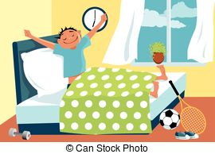
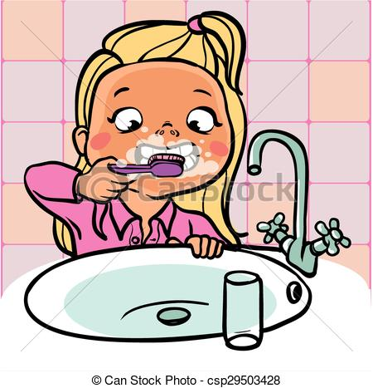
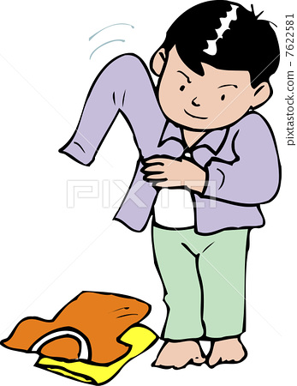
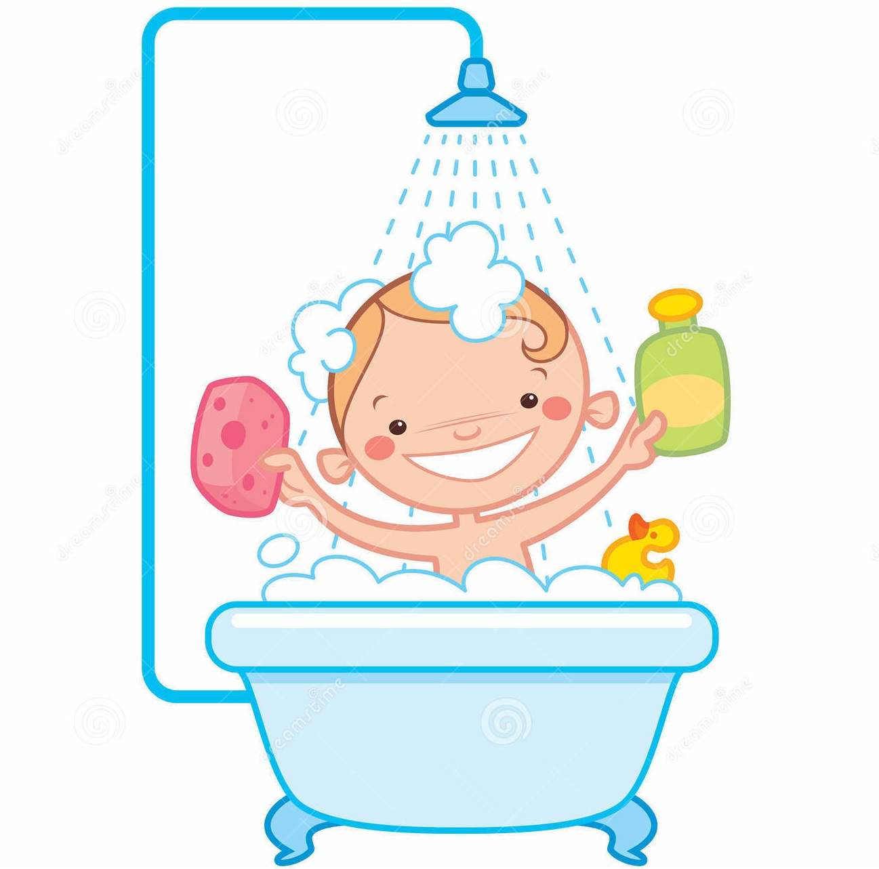
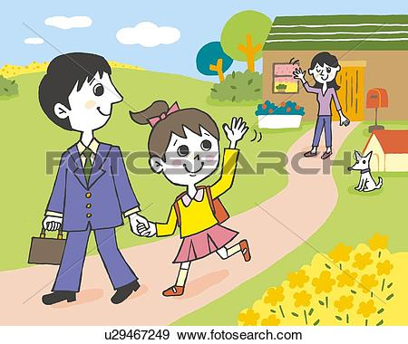
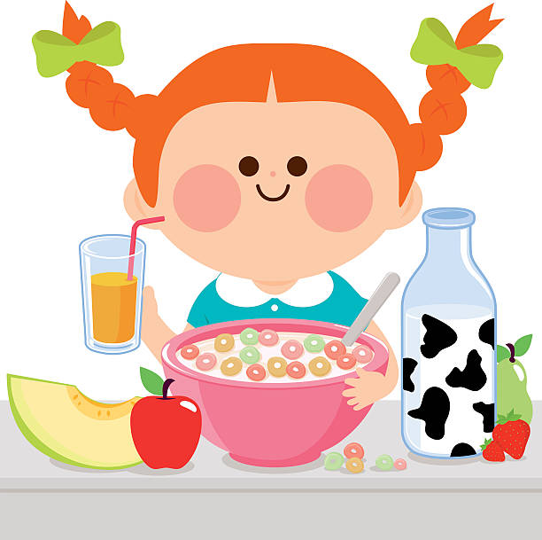
Sequencing Events/ Chronological Order
What would your order be for your morning routine?

Slide 7
Timeline:
Create a timeline of some of the most important things in your life. You can use this to help you plan your autobiography. Your events should be in chronological order like mine are. You may want to turn your page landscape and write above and below the timeline alternately to save space.
When my younger brother was born
First football match
Learning to play guitar
Starting sixth form
Starting University
Becoming a teacher
My family
Birth
Primary school
Holiday
Starting secondary school
Getting my pets
Friends
Final school performance
Completing my degree

